Slide 1

IST 597: Foundations of Data Privacy History and definitions
January 27, 2021

Slide 2
Logistics,
Groups, etc.
https://docs.google.com/document/d/1TYMT4HfcAcw4HR930UufaWkSO7xEWlQtc-32ma00ZVY/edit
Homework 1: due February 7 (2 weeks from today)

Slide 3
Class Outline
Legal-philosophical approaches to privacy
Psycho-social approaches to privacy
Economic approaches to privacy
Engineering approaches to privacy
Threats to privacy
Break & Brainstorming (30 minutes)
How this stuff applies in your research? (over to you)

Slide 4
A quick tour through the history of privacy
https://www.youtube.com/watch?v=SCmKJyVx9AY
Look out for answers to the following three questions:
1. What three technological shifts around the 1880s kickstarted conversations about privacy?
2. According to Helen Nissenbaum, how is Facebook like a utility company?
3. What is the major piece of legislation in effect today about privacy? When was it written?
Notes:
Camera; 2. telephone; 3. Western Union
Participation in social media is not optional anymore
Electronic communications privacy act of 1986

Slide 5
Legal-philosophical approaches to privacy

Slide 6
Privacy as Control
(Westin, 1968) “The claim of individuals, groups, or institutions to determine themselves when, how and to what extent information about them is communicated to others.”
(Altman, 1975) “The selective control of access to the self or to one’s group.”
(Warren and Brandeis, 1980) The right to privacy is the right to be let alone.
---> Reflect privacy as an inherent precondition for autonomy.
and others..

Slide 7
Westin’s four states of privacy (1968)
Solitude
individual separated form the group and freed form the observation of other persons
Intimacy
individual is part of a small unit
Anonymity
individual in public but still seeks and finds freedom from identification and surveillance
Reserve
the creation of a psychological barrier against unwanted intrusion - holding back communication
Notes:
Class discussion: What are examples of each?

Slide 8
How do you give people control over their personal information?

Slide 9
Notice and Consent
People should be informed about how organizations/others plan to store, use or exchange their personal data, and they should be asked for consent.

Slide 10
(Solove, 2012) Privacy self-management and the “consent dilemma”:
→ Argues that privacy self-management does not provide meaningful control.
“There are too many entities collecting and using personal data to make it feasible for people to manage their privacy separately with each entity. Moreover, many privacy harms are the result of an aggregation of pieces of data over a period of time by different entities. It is virtually impossible for people to weigh the costs and benefits of revealing information or permitting its use or transfer without an understanding of the potential downstream uses.... In addition, privacy self-management addresses privacy in a series of isolated transactions guided by particular individuals. Privacy costs and benefits, however, are more appropriately assessed cumulatively and holistically — not merely at the individual level.”

Slide 11
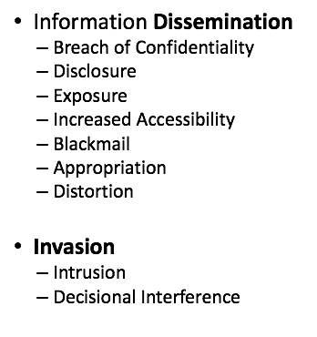
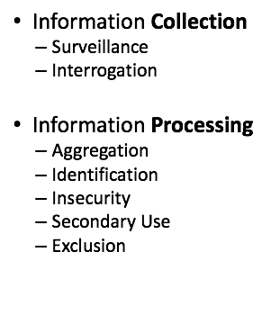
Solove’s taxonomy of privacy (2006)
https://www.law.upenn.edu/journals/lawreview/articles/volume154/issue3/Solove154U.Pa.L.Rev.477(2006).pdf
How much do we routinely know about these steps anyway?

Slide 12
Privacy as Contextual Integrity
(Nissenbaum, 2011) Privacy is adherence to expected flows of personal information, modeled with the construct of context-relative informational norms.
Context = Structured social settings (“Institutions”) characterized by roles, relationships, power structures, canonical activities, strategies, norms (rules), enforcement mechanisms, and internal values (goals, ends, purposes)
E.g., healthcare, education, politics, religious observance

Slide 13
Information
of a certain type
about a subject
from a sender
to a recipient
is governed by transmission principles.
E.g., consent, notice, compulsion, confidentiality, sale, barter, entitlement, reciprocity, need, secrecy,…

Slide 14
Legal Frameworks invoke CI implicitly
Privacy conversations are often framed by expectations of privacy.
In fact, the “reasonable expectation of privacy” is a legal test crucial in defining scope of acceptable surveillance.
Reasonable expectation often comes down to context.
E.g., hotel room vs. street corner
Highly dynamic in today’s technology landscape!
Walking down the street, one could argue you could expect to be watched. But, should you also expect to be:
Identified (e.g., facial recognition)
Tracked (e.g., mobile-phone tracking)
Recorded (e.g., audio bugging, infrared cameras)

Slide 15
On the Internet, you might share information in a public forum. But, should you expect this information be harvested, aggregated, analyzed, and used for specific purposes (not intended by you)?

Slide 16
Laws and Directives
The “how to collect data”
Guidelines

Slide 17
Privacy Law and Policy
Disclaimer: We take a ’Western’ perspective (US/Europe)
→Privacy is perhaps the oldest legal principle. Function: protect citizens from states entering the private domain.
Van der Sloot compares where privacy is protected within the Constitutions of various European nations. In the US:
‣ 1st, 4th, 5th, 9th, 14th amendments to US Constitution
‣ State Constitutions
‣ Federal Laws (FTC, COPPA, HIPAA)
‣ State Laws (e.g., California Electronic Communications Privacy Act)
‣ Supreme court cases
Bart van der Sloot. “Privacy from a Legal Perspective.” https://ssrn.com/abstract=3299047

Slide 18
FAIR INFORMATION PRACTICE PRINCIPLES

Slide 19
Fair Information Practices (FIPs) → The Privacy Act (1974)
There must be no personal data record-keeping systems whose very existence is secret. Transparency
There must be a way for a person to find out what information about the person is in a record and how it is used. Use limitation
There must be a way for a person to prevent information about the person that was obtained for one purpose from being used or made available for other purposes without the person’s consent. Access and correction
There must be a way for a person to correct or amend a record of identifiable information about the person. Data quality
Any organization creating, maintaining, using, or disseminating records of identifiable personal data must assure the reliability of the data for their intended use and must take precautions to prevent misuses of the data. Security
U.S. Department of Health, Education and Welfare, Report of the Secretary’s Advisory Committee on Automated Personal Data Systems, Records, Computer, and the Rights of Citizens (1973).

Slide 20
OECD guidelines – seek to “harmonize national privacy legislation and, while upholding such human rights…at the same time prevent interruptions in international flows of data”
Collection Limitation Principle—There should be limits to the collection of personal data and any such data should be obtained by lawful and fair means and, where appropriate, with the knowledge or consent of the data subject.
Data Quality Principle—Personal data should be relevant to the purposes for which they are to be used, and, to the extent necessary for those purposes, should be accurate, complete and kept up-to-date.
Purpose Specification Principle—The purposes for which personal data are collected should be specified not later than at the time of data collection and the subsequent use limited to the fulfillment of those purposes or such others as are not incompatible with those purposes and as are specified on each occasion of change of purpose.
Use Limitation Principle—Personal data should not be disclosed, made available or otherwise used for purposes other than those specified in accordance with [the Purpose Specification Principle] except: (a) with the consent of the data subject; or (b) by the authority of law.
Committee of Ministers of the Organization for Economic Cooperation and Development (1980).

Slide 21
Security Safeguards Principle—Personal data should be protected by reasonable security safeguards against such risks as loss or unauthorised access, destruction, use, modification or disclosure of data.
Openness Principle—There should be a general policy of openness about developments, practices and policies with respect to personal data. Means should be readily available of establishing the existence and nature of personal data, and the main purposes of their use, as well as the identity and usual residence of the data controller.
Individual Participation Principle—An individual should have the right: (a) to obtain from a data controller, or otherwise, confirmation of whether or not the data controller has data relating to him; (b) to have communicated to him, data relating to him within a reasonable time(…)
Accountability Principle—A data controller should be accountable for complying with measures which give effect to the principles stated above.
Committee of Ministers of the Organization for Economic Cooperation and Development (1980).

Slide 22
The FTC Privacy Principles (mid-1990s) – reviewed FIP codes of US, Canada, Europe and found those “common to all” as five core principles of privacy protection
Notice/awareness
Choice/consent
Access/participation
Integrity/security
Enforcement/redress
*Clear focus on notice and choice, which Nissenbaum and others have explored in the context of big data.
Notice as envisioned no longer possible
Costs of choice, Illusion of choice
FTC Advisory Committee on Online Access and Security. Privacy Online: A Report to Congress (“1998 Report”)

Slide 23
Consumer Privacy Protection Principles (CPPPS, 2006)
*Argument: FIPs have failed.
Prevention of harm
Benefits maximization
Consistent protection
Transparency, honest, accountability
Integrity of personal information
Security
Liability
Effective and efficient enforcement
*First three establish purpose of data protection and provide standards for interpreting other principles.
https://www.ftc.gov/system/files/documents/public_comments/2018/12/ftc-2018-0098-d-0036-163372.pdf

Slide 24
EUROPE/GDPR

Slide 25
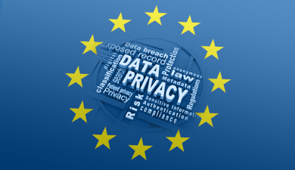
Protects individuals in 28 member countries of the EU, even if data is processed elsewhere
Privacy commissions established in each country

Slide 26
EU General Data Protection Regulation (GDPR; 2016)
“the most consequential regulatory development in information policy in a generation” – Hoofnagle, 2019
Strict, enforceable* privacy and security law *fines for violation very high
Far-reaching, light on specifics
Applies to organizations anywhere so long as they target or collect data related to people in EU
Major focus areas: Data protection principles (e.g., data minimization, accuracy storage limitations); Accountabiliy (e.g., train staff, contracts with third parties); Security (e.g., encryption); Data protection by design and by default; Allowable data processing (e.g., subject gave you unambiguous consent to process, comply with a legal obligation, “save somebody’s life”); Consent (e.g., “freely given, specific, informed and unambiguous”, over 13 years old); Data Protection officers; People’s privacy rights (e.g., access, rectification)
Regulation (EU) 2016/679 of the European Parliament and of the Council of 27 April 2016 on the protection of natural persons with regard to the processing of personal data and on the free movement of such data, and repealing Directive 95/46/EC (General Data Protection Regulation), OJ 2016 L 119/1 <http://ec.europa.eu/justice/data-protection/reform/files/regulation_oj_en.pd

Slide 27
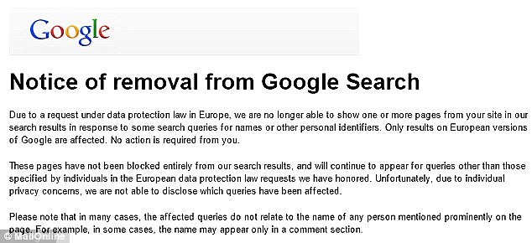
The right to be forgotten…
Notes:
EU countries recognize privacy as fundamental human right
http://www.dailymail.co.uk/news/article-3442392/Google-hide-content-removed-using-right-forgotten-ruling-versions-search-engine.html

Slide 28
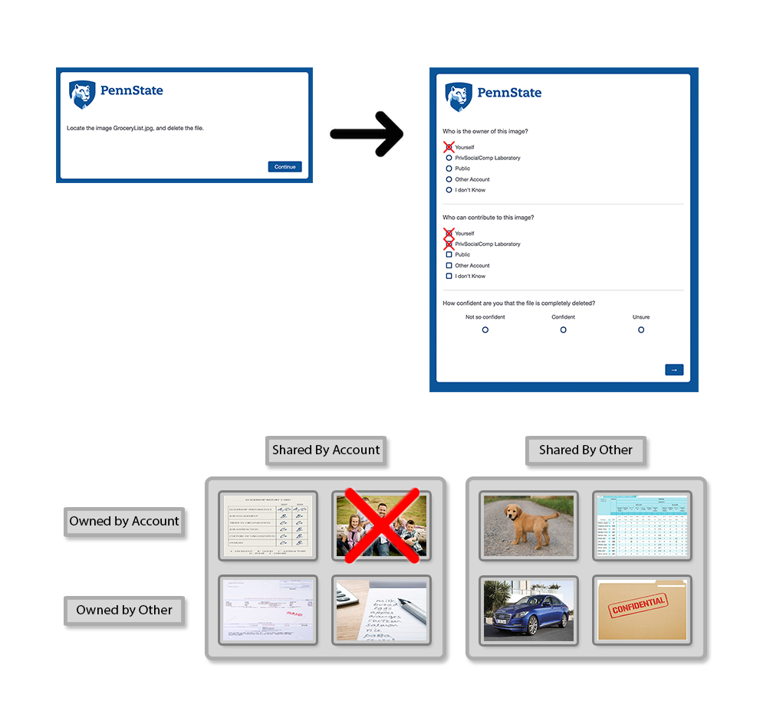
A parenthesis: users’ perception and privacy on cloud providers
How long does Google (or your favorite cloud provider) keep your data for?
Once you hit “delete” is it gone? Gone gone or just “gone” from your sight ?
How does it work when content is NOT yours but it’s shared with you?
(Work of Dr. Anna Squicciarini…)

Slide 29
Social science approaches to privacy
(although I mean this in a narrow sense for today)

Slide 30
People (apparently) like to share personal information

Slide 31
“Self-disclosure”
I am a father of 4 and two step children I work with special needs children in Long Island NY and a DJ my DJ business picks up the slack but as this pandemic grips business is done
Professional status
Family status
Location

Slide 32

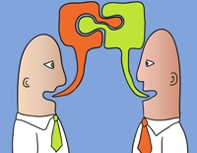
Self-disclosure for relationship development
Social Penetration Theory: Interpersonal connectedness and relationship development is fundamentally facilitated through iterative self-disclosure
I am a father of 4 and two stepchildren I work with special needs children in Long Island NY and a DJ my DJ business picks up the slack but as this pandemic grips business is done
Notes:
The literature on social communication suggests that interpersonal connectedness and relationship development is fundamentally facilitated through iterative self-disclosure, that is, intentionally revealing personal information such as personal motives, desires, feelings, thoughts, and experiences to others.
People share personal information in exchange for social reward, i.e., engagement, support, legitimacy. Consistent with
this definition, we believe that the observed social convergence and the corresponding rise in self-disclosure in online public
platforms during this pandemic serve various, important functional purposes for users during this difficult time.

Slide 33
Self-Disclosure and the Covid context
Emotional disclosure
Feelings, Opinions, Subjective content
Informational
Facts, demographic data etc.
This corona virus thing is driving me crazy i just want to cry I'm so worried about my family and loved ones. I hope this stuff goes away SOON. I came close to breaking down and crying today already ugh
Waiting on my Covid test results. Worried about my 12 yo son who's immunocompromised, my 23 yo daughter who lives in Queens, my 25yo son with asthma, my newborn grandson, and sad for my almost 21yo who will toast her special day in quarantine. This sucks. #ThisNest #RN #Mom"
Notes:
Study online self-disclosure during the Coronavirus epidemic. This research will help us detect acts of self-disclosure in online settings and learn how oversharing is expedited or even encouraged during the Coronavirus crisis.

Slide 34
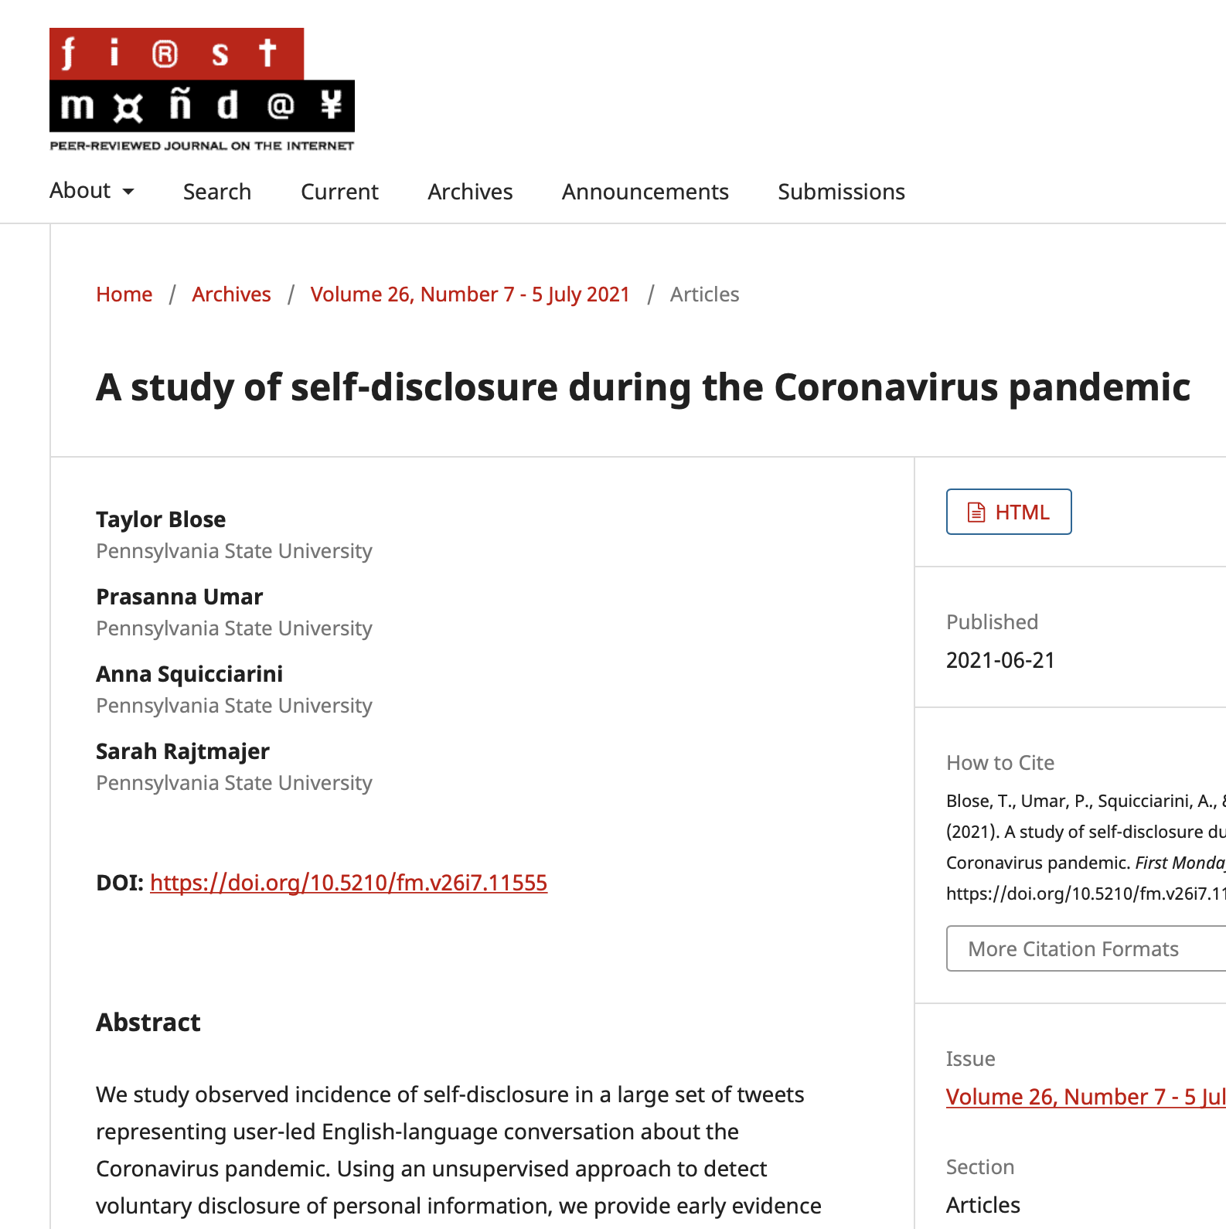
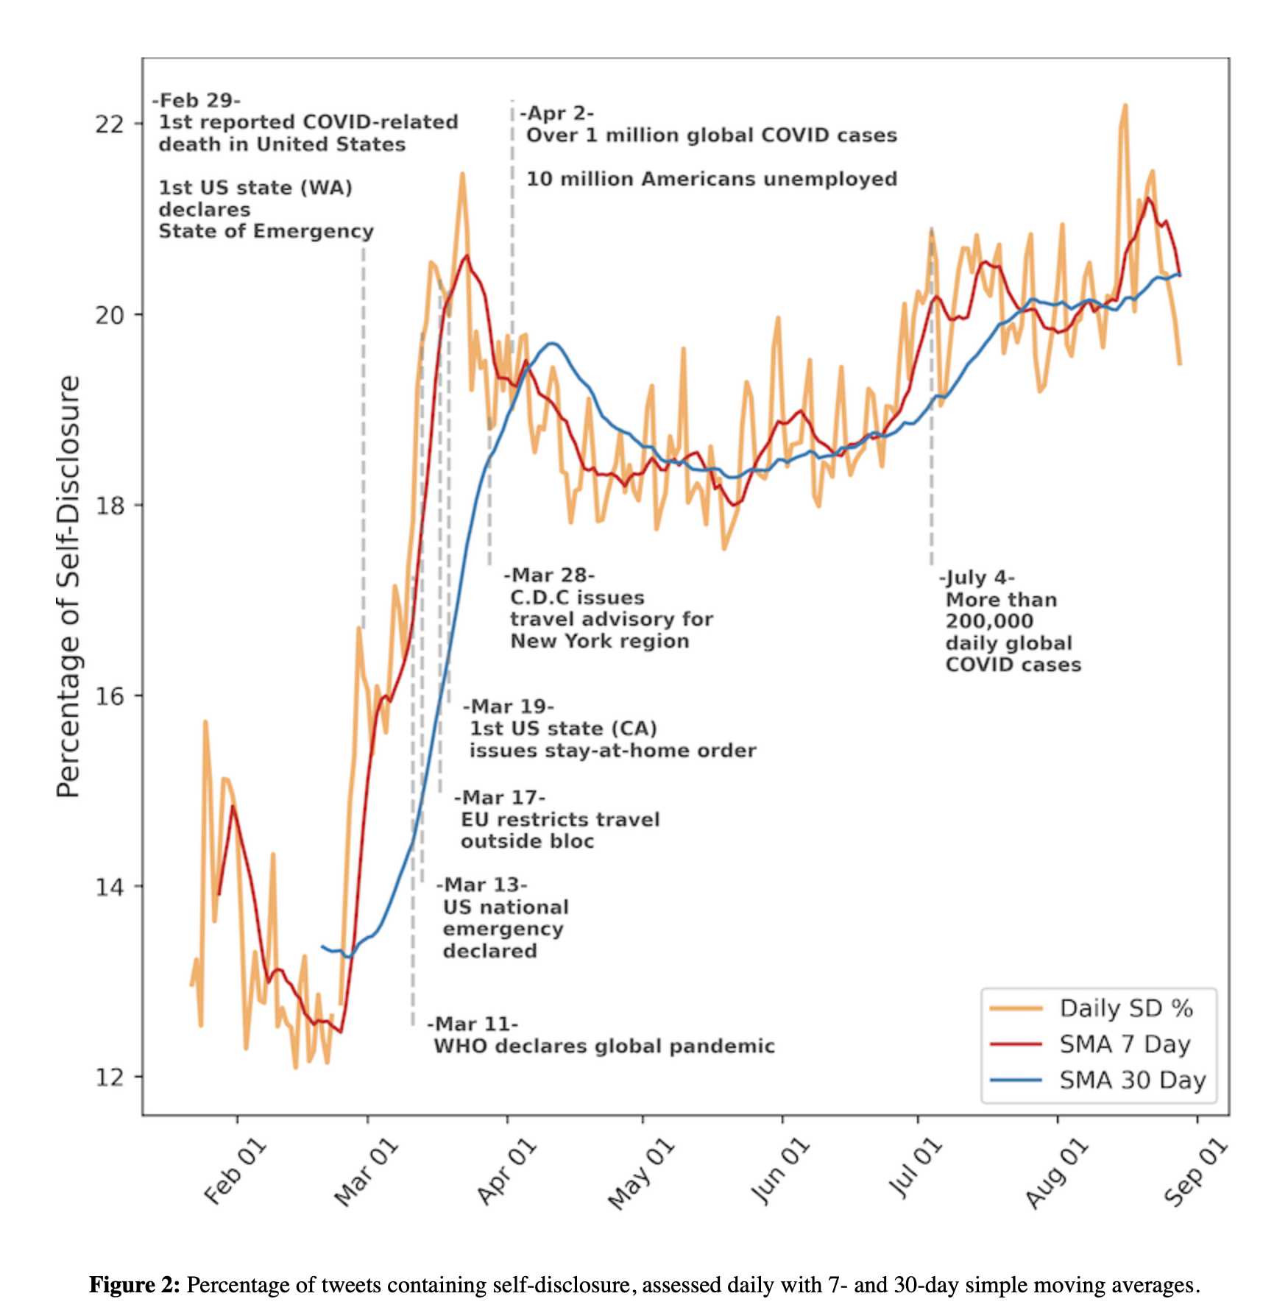

Slide 35
Economic approaches to privacy

Slide 36
Does (your) personal information have value?
Value to you or value to others?
What/who determines that value?
Notes:
point 4 Remember the incientive of big data is the VALUE of the data and the type of analytical processes that it can undergo.
Cambridge Analytica
https://www.youtube.com/watch?v=HAgbIiQSzEk

Slide 37
Economics of Privacy
Economics of privacy attempts to study the costs and benefits associated with the protection or disclosure of personal data - for the data subject, the data holder, and for society as a whole.

Slide 38
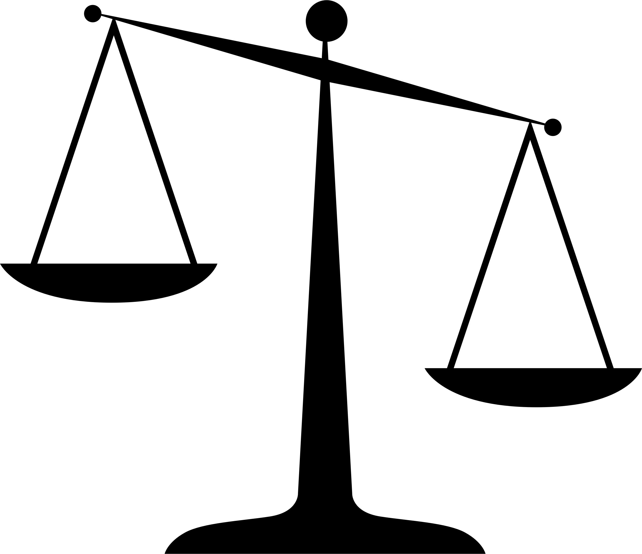

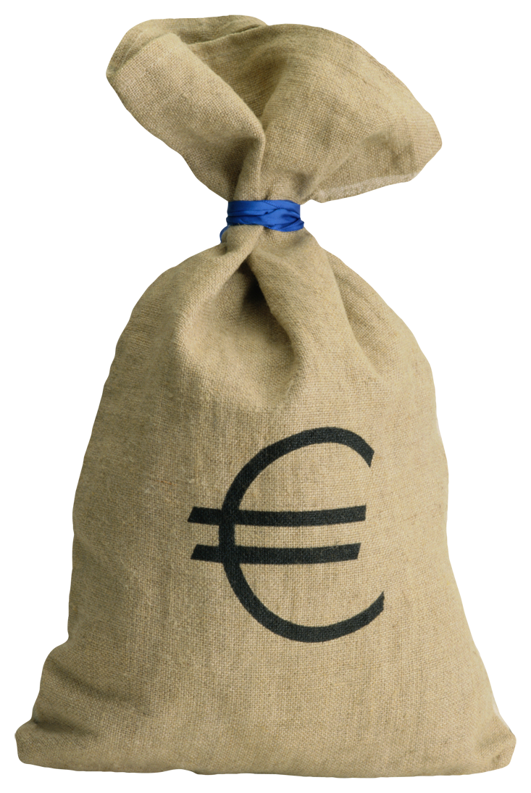
Data Privacy and Utility Individual and societal

Slide 39
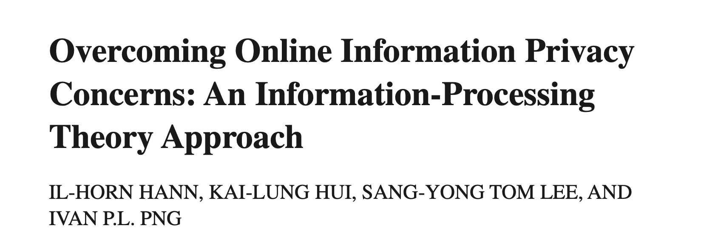
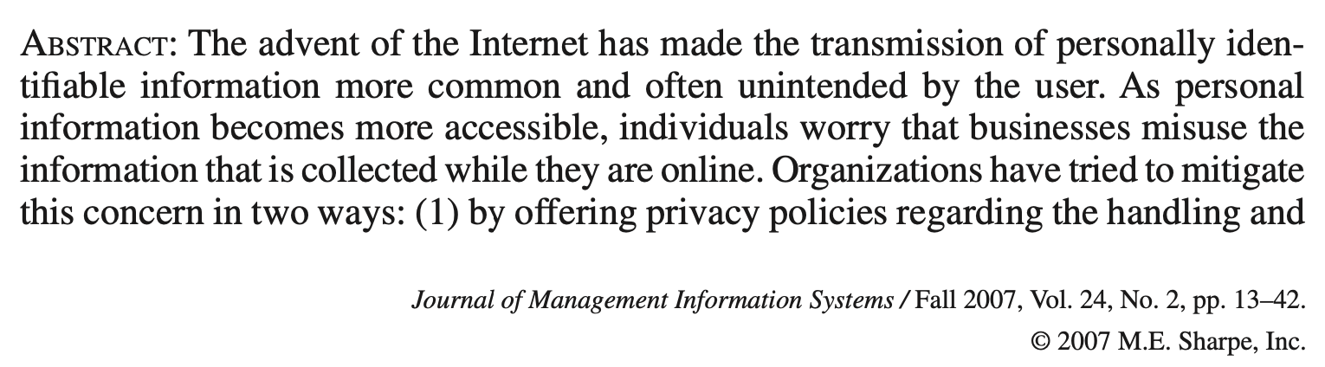
Attempts to valuate personal data
This 2007 study:
Suggest the value that US subjects assign to protection against improper access and secondary uses of personal information on a single Web site to be between $30.49 and $44.62.
Suggests there are three types of Internet users – privacy guardians, information sellers, and convenience seekers. (background: the Web sites were travel sites and collected users’ name, home address, phone number, email address, occupation, travel purpose, and more)
Notes:
In the privacy literature, control over personal information flows is often constructed as instrumental to privacy protection – so much so that both data holding companies and reguprivacylators point to control as key to the solution of contemporary privacy challenges. Yet, we show that “more” control can lead to “less”, in the sense of higher objective risks associated with personal information disclosure. (Brandimarte, Acquisti, and Loewenstein. Misplaced Confidences: Praivacy and the Control Paradox, 2013)
Control over release of PI versus control over access and usage of the info by others
Our hypotheses are that (1) perceived control influences people’s willingness to reveal personal information, and (2) in judging the extent of control, people tend to focus on issues of release at the expense of issues of access and usage – even though objective risks from disclosure arise from whether and how information is accessed and used, not merely how it is released.
participants with lower control over information release were significantly less willing to answer personal questions, but especially so for more intrusive questions.
Three experiments provide empirical evidence that perceived control over release plays a critical role in (over)sharing personal information, relative to the objective risks associated with information access and usage by others. In Study 1, people responded to manipulations that decreased control over information release, even though risks associated with information access and use by others were in fact decreased. In Study 2, concerns related to accessibility of private information were trumped by control over release, even though the objective risks associated with revealing sensitive information depend more on the former than the latter. In Study 3, when participants were given explicit control over the release of their personal information, they tended to reveal more, even exposing themselves to higher risks of identifiability.

Slide 40
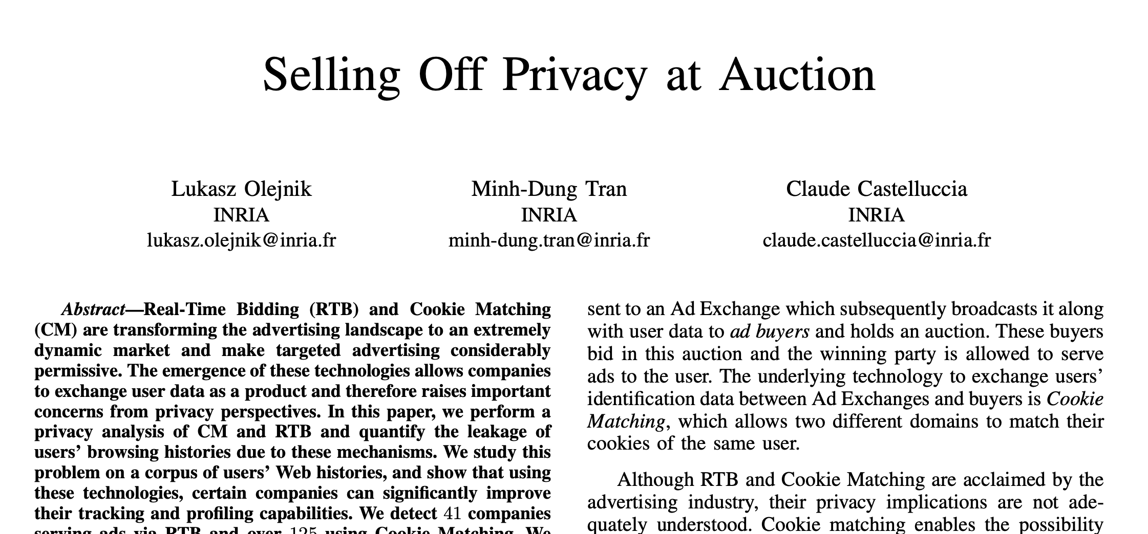
Attempts to valuate personal data
This 2014 study:
Attempts to pinpoint the value of users’ browsing histories (note: companies use these for tracking and profiling)
Study reveals huge gap between users’ perception of the value of their personal information and its actual value on the market.
On average, users evaluate the price of the disclosure of their presence on a Web site to EUR 7; while, users’ browsing history elements are routinely being sold off for less than $0.0005.
Value of browsing history varies with: whether user is historical vs new; the sites visited; time and users’ physical location; etc.
Notes:
In the privacy literature, control over personal information flows is often constructed as instrumental to privacy protection – so much so that both data holding companies and regulators point to control as key to the solution of contemporary privacy challenges. Yet, we show that “more” control can lead to “less” privacy, in the sense of higher objective risks associated with personal information disclosure. (Brandimarte, Acquisti, and Loewenstein. Misplaced Confidences: Praivacy and the Control Paradox, 2013)
Control over release of PI versus control over access and usage of the info by others
Our hypotheses are that (1) perceived control influences people’s willingness to reveal personal information, and (2) in judging the extent of control, people tend to focus on issues of release at the expense of issues of access and usage – even though objective risks from disclosure arise from whether and how information is accessed and used, not merely how it is released.
participants with lower control over information release were significantly less willing to answer personal questions, but especially so for more intrusive questions.
Three experiments provide empirical evidence that perceived control over release plays a critical role in (over)sharing personal information, relative to the objective risks associated with information access and usage by others. In Study 1, people responded to manipulations that decreased control over information release, even though risks associated with information access and use by others were in fact decreased. In Study 2, concerns related to accessibility of private information were trumped by control over release, even though the objective risks associated with revealing sensitive information depend more on the former than the latter. In Study 3, when participants were given explicit control over the release of their personal information, they tended to reveal more, even exposing themselves to higher risks of identifiability.

Slide 41
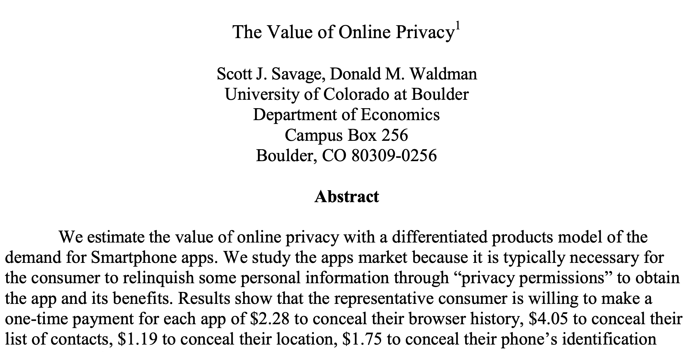
Attempts to valuate personal data
This 2013 study:
Finds a consumer is willing to make a one-time payment of $2.28 for each smartphone application to conceal their browser history
$4.05 to conceal their contacts lists
$1.19 to conceal their location
$1.75 to conceal their phone’s identification number
$3.58 to conceal the contents of their text messages
$2.12 to eliminate advertising
Notes:
In the privacy literature, control over personal information flows is often constructed as instrumental to privacy protection – so much so that both data holding companies and regulators point to control as key to the solution of contemporary privacy challenges. Yet, we show that “more” control can lead to “less” privacy, in the sense of higher objective risks associated with personal information disclosure. (Brandimarte, Acquisti, and Loewenstein. Misplaced Confidences: Praivacy and the Control Paradox, 2013)
Control over release of PI versus control over access and usage of the info by others
Our hypotheses are that (1) perceived control influences people’s willingness to reveal personal information, and (2) in judging the extent of control, people tend to focus on issues of release at the expense of issues of access and usage – even though objective risks from disclosure arise from whether and how information is accessed and used, not merely how it is released.
participants with lower control over information release were significantly less willing to answer personal questions, but especially so for more intrusive questions.
Three experiments provide empirical evidence that perceived control over release plays a critical role in (over)sharing personal information, relative to the objective risks associated with information access and usage by others. In Study 1, people responded to manipulations that decreased control over information release, even though risks associated with information access and use by others were in fact decreased. In Study 2, concerns related to accessibility of private information were trumped by control over release, even though the objective risks associated with revealing sensitive information depend more on the former than the latter. In Study 3, when participants were given explicit control over the release of their personal information, they tended to reveal more, even exposing themselves to higher risks of identifiability.

Slide 42
But… all of this is very context-dependent, and people are also inconsistent and subject to behavioral heuristics

Slide 43
AN EXPERIMENT

Slide 44
Experiment 1
You are shopping online. A banner for a discount comes up: You have received a $10 gift card, or you can actually get $12 if you want to share your shopping data (what you looked at, what you bought, etc., on the site).
I take the 12$ gift card
I take the 10$ gift card.

Slide 45
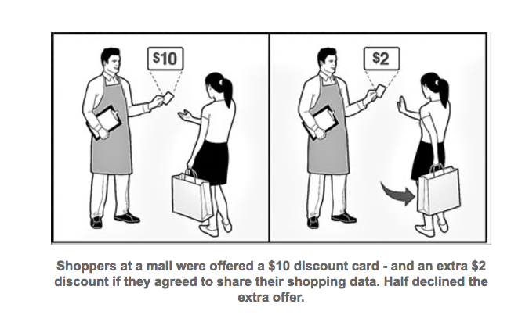

Slide 46
Experiment 2
You are shopping online. A banner for a discount comes up: You have received a $10 $12 gift card, or you can get $12 $10 if you want to share your shopping data (what you looked at, what you bought, etc., on the site). keep your shopping data private.
I take the 12$ gift card
I take the 10$ gift card.

Slide 47
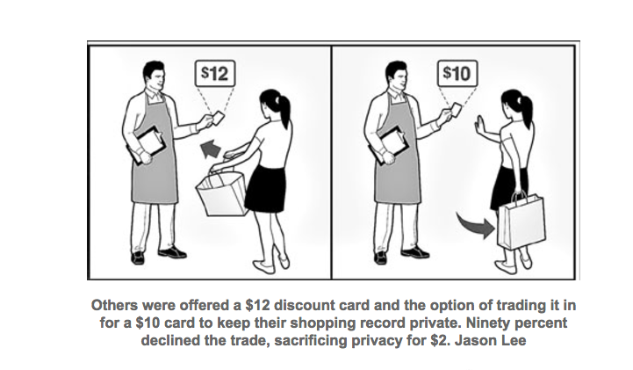
“Endowment effect” (divestiture aversion)
Notes:
People attach much greater value to their data if it is on “sale” than they would be willing to spend to ensure it was not revealed.
In the study some 50% said NO to the extra 2$
But over 90% decided to keep the 12$.
In psychology and behavioral economics, the endowment effect (also known as divestiture aversion and related to the mere ownership effect in social psychology^{[1]}) is the hypothesis that people ascribe more value to things merely because they own them.[
This is typically illustrated in two ways.^{[3]} In a valuation paradigm, people will tend to pay more to retain something they own than to obtain something they do not own—even when there is no cause for attachment, or even if the item was only obtained minutes ago. In an exchange paradigm, people given a good are reluctant to trade it for another good of similar value. For example, participants first given a Swiss chocolate bar were generally unwilling to trade it for a coffee mug, whereas participants first given the coffee mug were generally unwilling to trade it for the chocolate bar.
A more controversial third paradigm used to elicit the endowment effect is the mere ownership paradigm, primarily used in experiments in psychology, marketing, and organizational behavior. In this paradigm, people who are randomly assigned to receive a good ("owners") evaluate it more positively than people who are not randomly assigned to receive the good ("controls").^{[1][3]} The distinction between this paradigm and the first two is that it is not incentive-compatible. In other words, participants are not explicitly incentivized to reveal the extent to which they truly like or value the good.
The endowment effect can be equated to the behavioural model Willingness to Accept or Pay (WTAP), a formula sometimes used to find out how much a consumer or person is willing to put up with or lose for different outcomes.

Slide 48
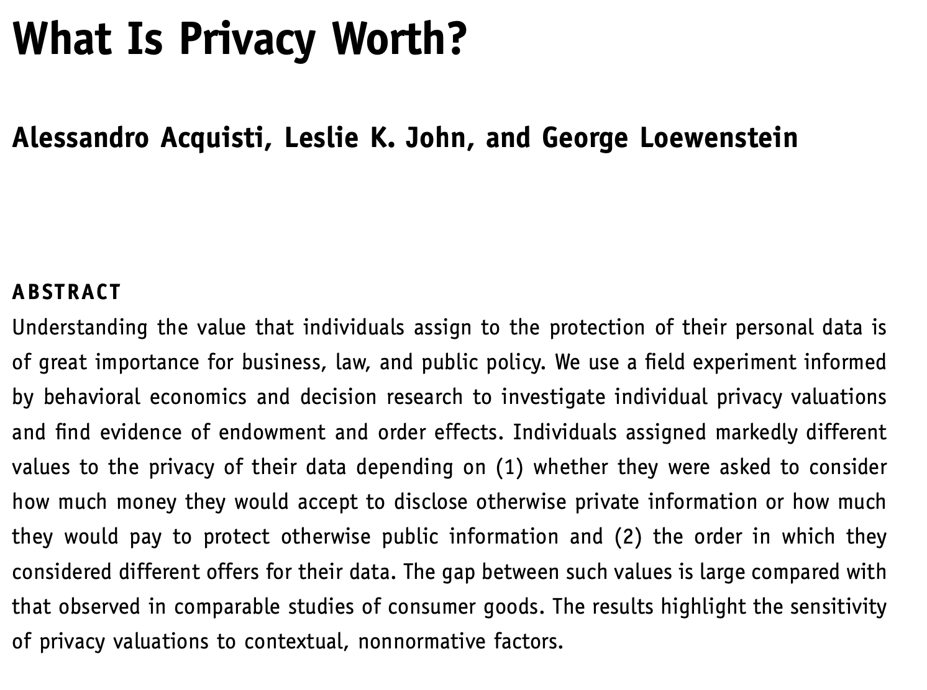
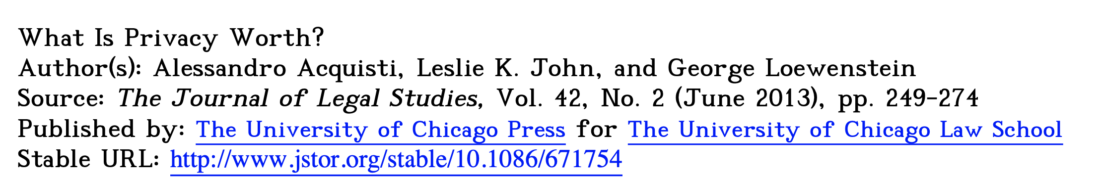

Slide 49

ZOOM OUT

Slide 50
General observation: Privacy concerns seem inconsistent with behavior
People say they want privacy, but don’t always take steps to protect it
Many possible explanations
They don’t really care that much about privacy
They prefer immediate gratification to privacy protections that they won’t benefit from until later
They don’t understand the privacy implications of their behavior
The cost of privacy protection (including figuring out how to protect their privacy) is too high

Slide 51
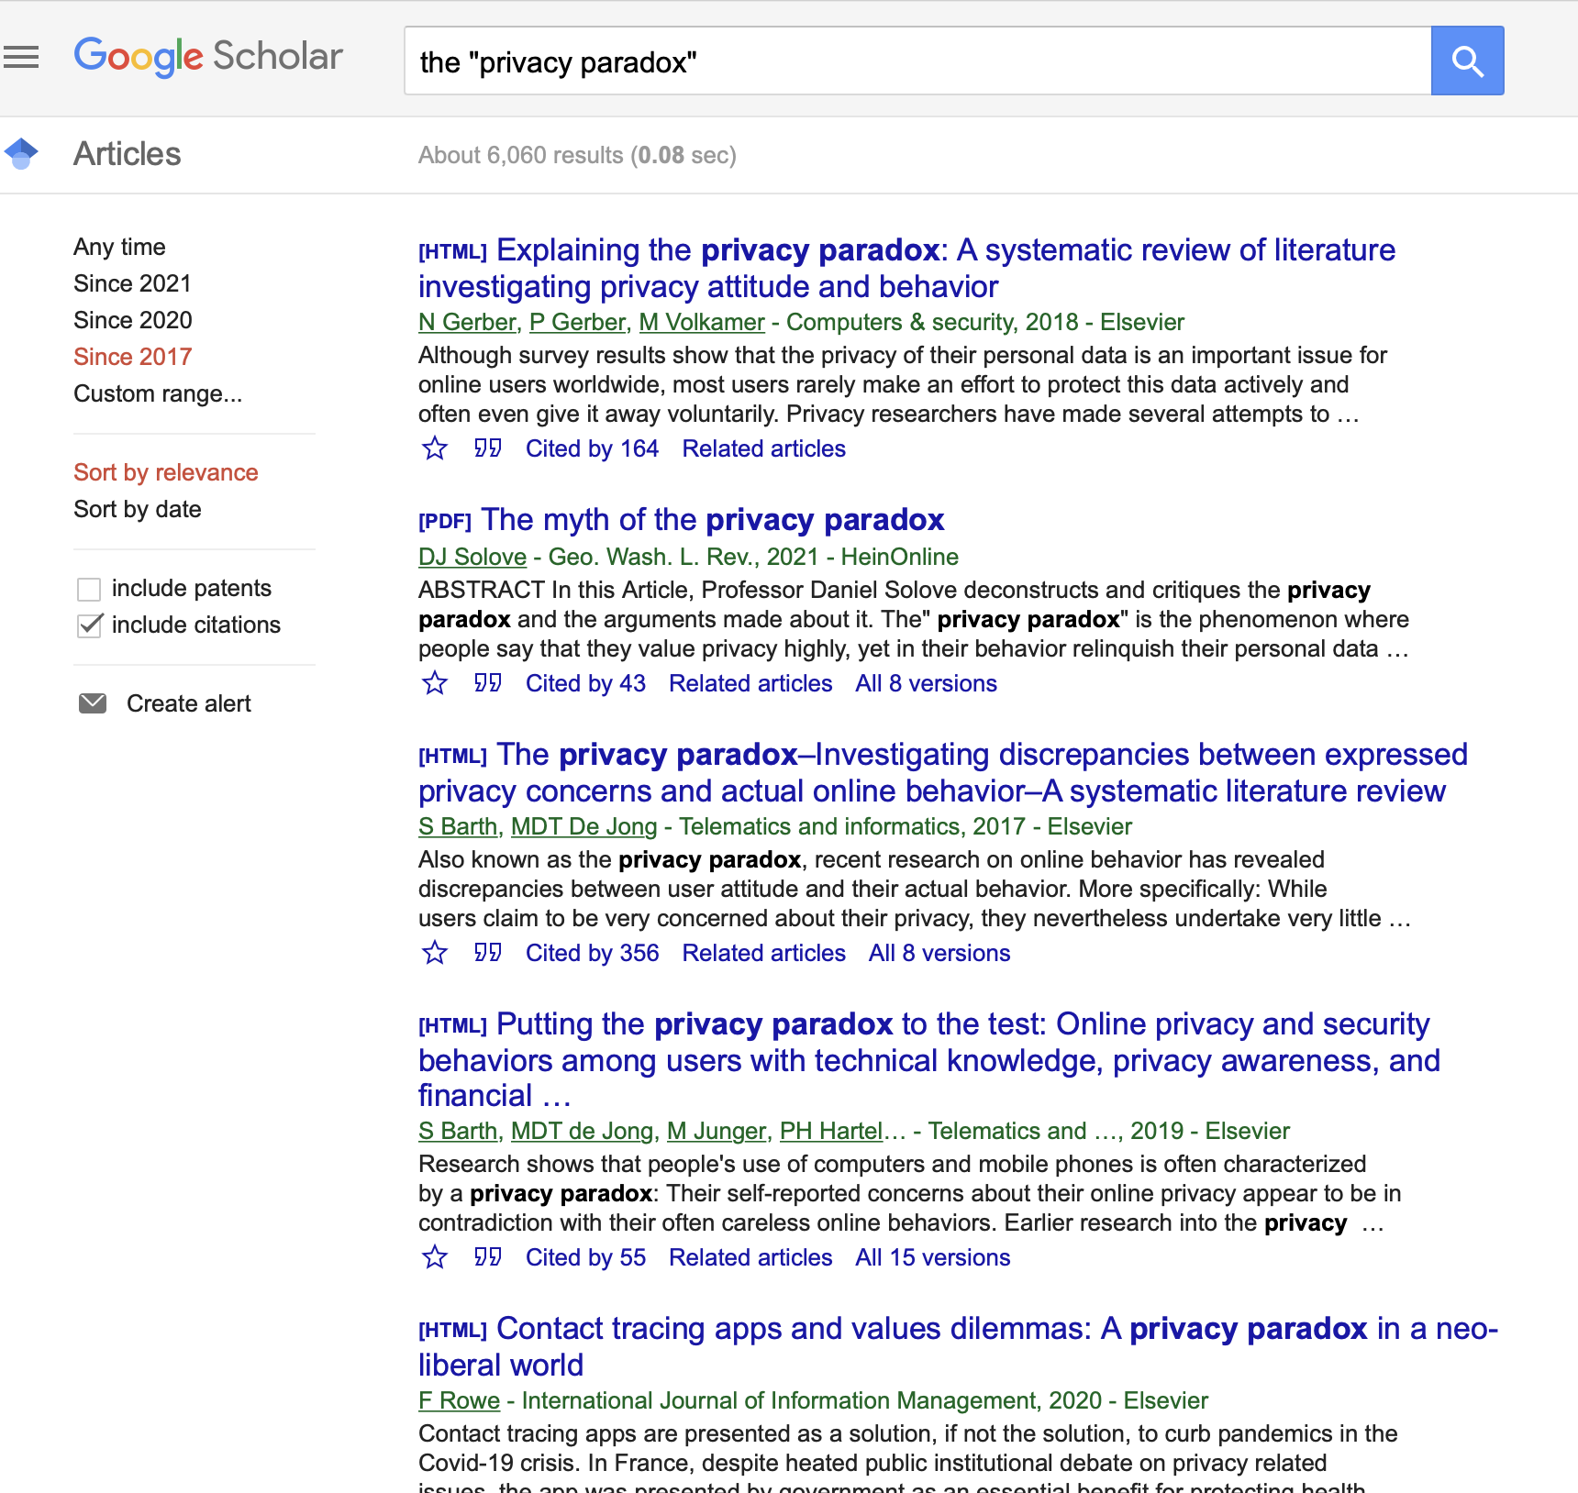
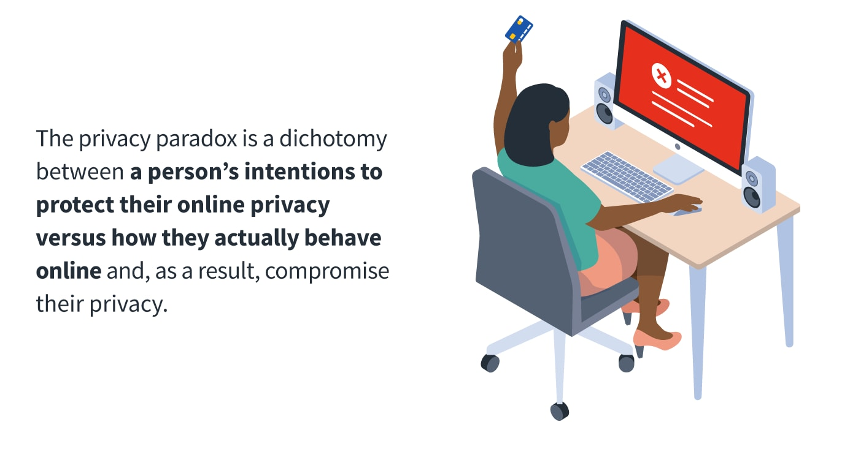
The “Privacy Paradox”

Slide 52
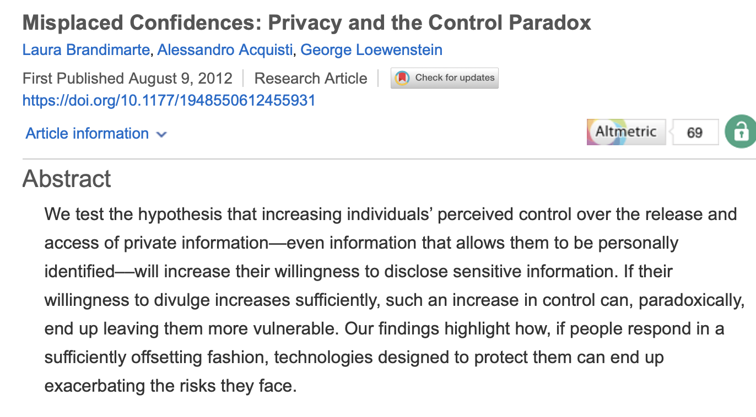
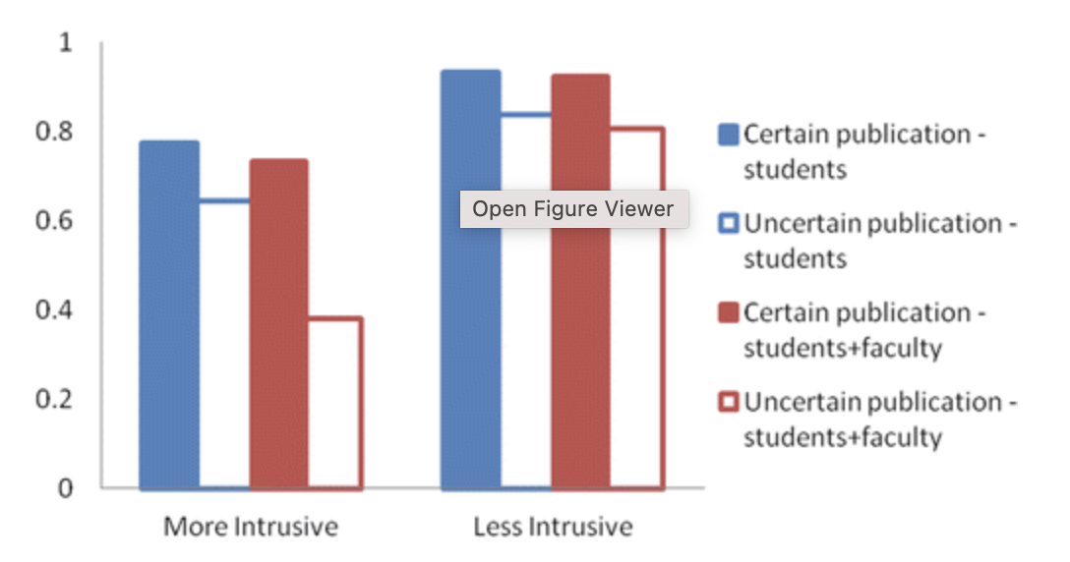
Privacy and the control paradox
Notes:
In the privacy literature, control over personal information flows is often constructed as instrumental to privacy protection – so much so that both data holding companies and regulators point to control as key to the solution of contemporary privacy challenges. Yet, we show that “more” control can lead to “less” privacy, in the sense of higher objective risks associated with personal information disclosure. (Brandimarte, Acquisti, and Loewenstein. Misplaced Confidences: Praivacy and the Control Paradox, 2013)
Control over release of PI versus control over access and usage of the info by others
Hypotheses are that (1) perceived control influences people’s willingness to reveal personal information, and (2) in judging the extent of control, people tend to focus on issues of release at the expense of issues of access and usage – even though objective risks from disclosure arise from whether and how information is accessed and used, not merely how it is released.
participants with lower control over information release were significantly less willing to answer personal questions, but especially so for more intrusive questions.
Three experiments provide empirical evidence that perceived control over release plays a critical role in (over)sharing personal information, relative to the objective risks associated with information access and usage by others. In Study 1, people responded to manipulations that decreased control over information release, even though risks associated with information access and use by others were in fact decreased. In Study 2, concerns related to accessibility of private information were trumped by control over release, even though the objective risks associated with revealing sensitive information depend more on the former than the latter. In Study 3, when participants were given explicit control over the release of their personal information, they tended to reveal more, even exposing themselves to higher risks of identifiability.

Slide 53
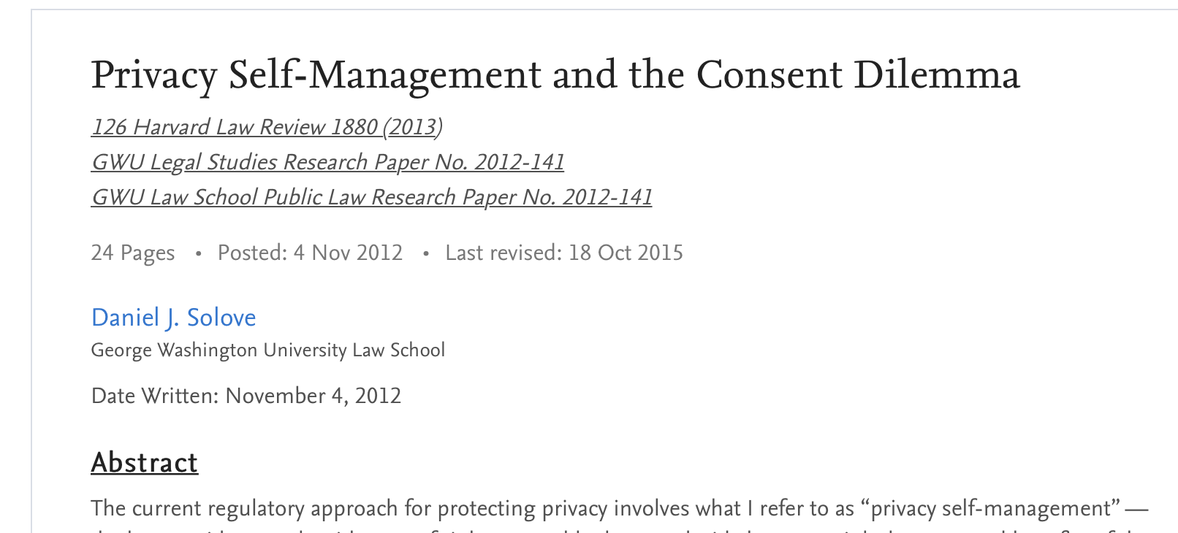
IT’S NOT A PARADOX ITS JUST IMPOSSIBLE!!!
(also, don’t blame the victim!)
…back to Solove and the consent dilemma
The current conversation around the privacy paradox is fundamentally misguided by faulty logic, wherein highly specific context-dependent behaviors are mapped to broad conclusions about how people value their data.

Slide 54
Privacy and fairness… MORE NEXT WEEK
→ Some people are less well-equipped to deal with these decision (privacy literacy)
→ Some people just have to deal with more surveillance
→ Some people’s personal information is more likely to be weaponized against them

Slide 55
Taking all of this into consideration... How can we design systems that support privacy and aid in privacy decision making??

Slide 56
Engineering approaches to privacy

Slide 57
Privacy Enhancing Technologies (PETs)

Slide 58
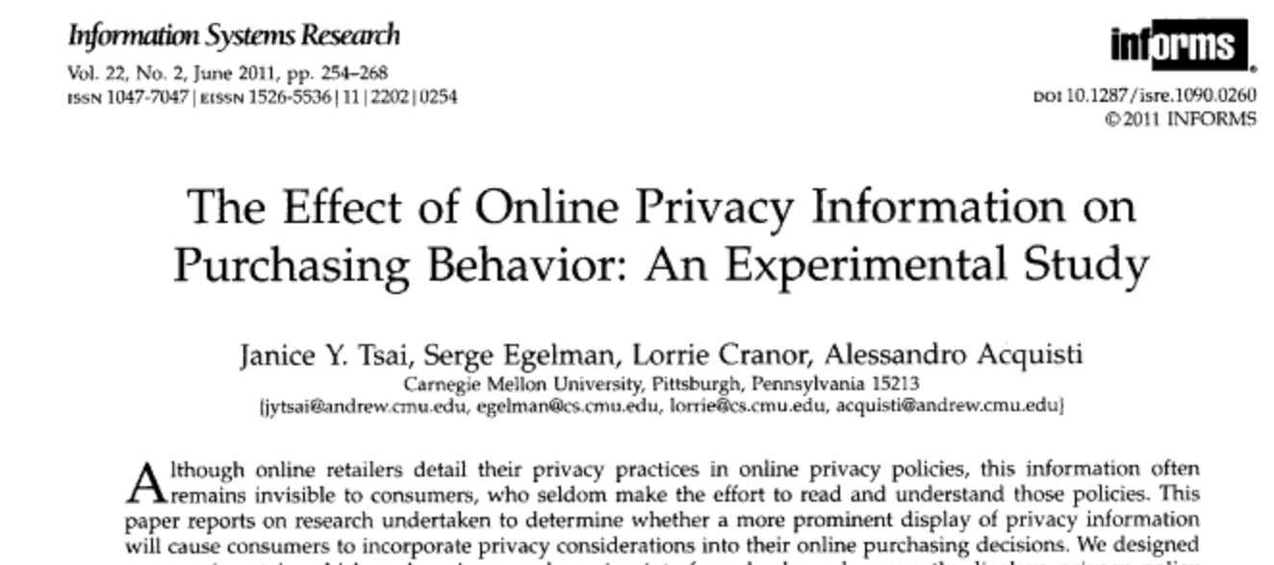
Remind people to think about their privacy?
Will the salient display of privacy information cause consumers to take privacy into account when making online purchasing decisions?
Yes!

Slide 59
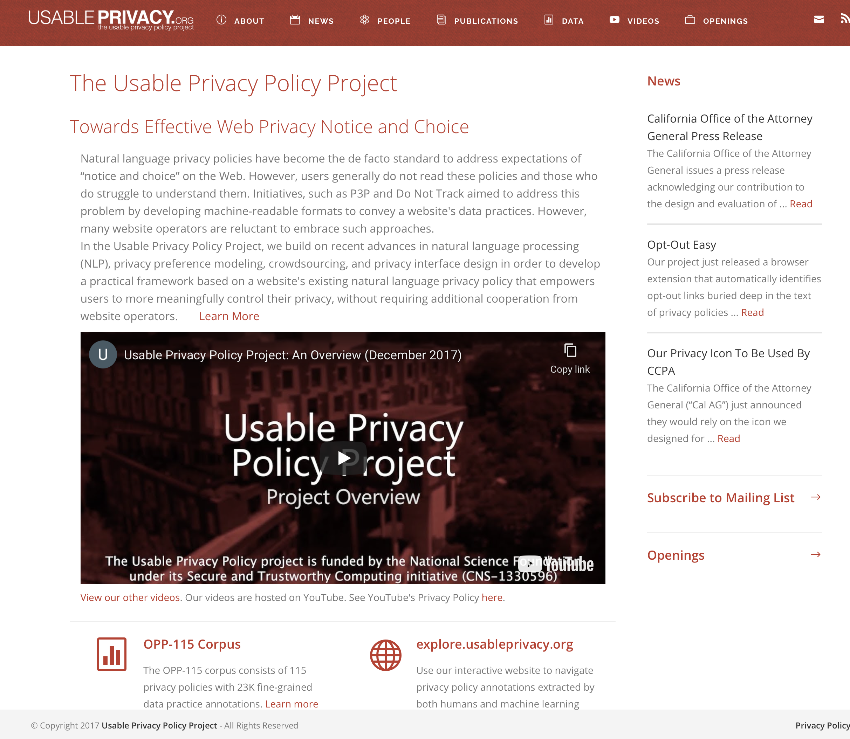
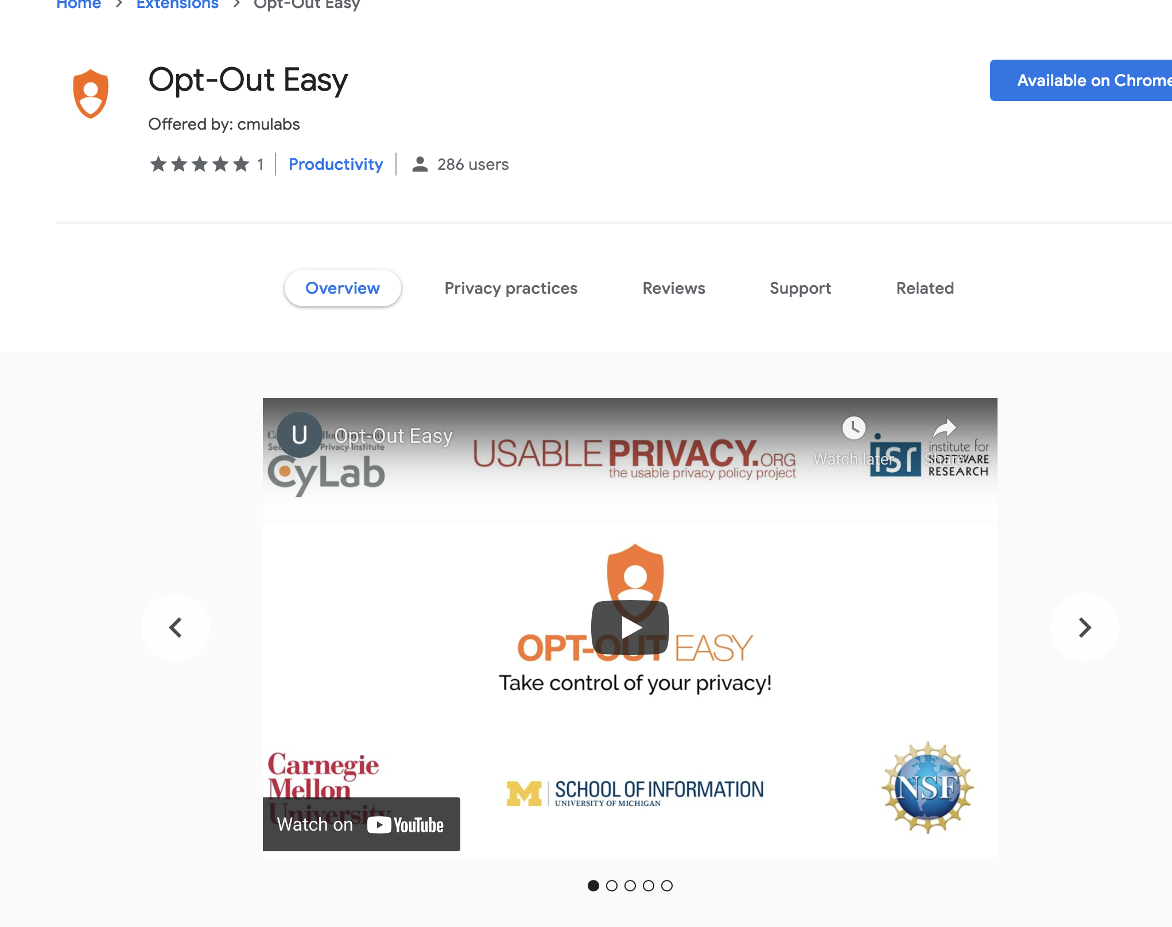
Notes:
See also: http://cups.cs.cmu.edu/soups/2006/proceedings/p133_gideon.pdf

Slide 60
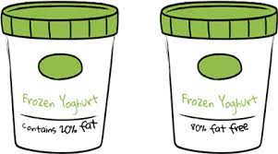
Help overcoming cognitive and behavioral biases, or leveraging cognitive and behavioral biases “for good”
E.g.,
Loss aversion
Framing effects
Optimism bias and overconfidence
Post-completion errors
Status quo bias
Notes:
Paper link: https://www.ftc.gov/system/files/documents/public_comments/2017/11/00031-141888.pdf

Slide 61
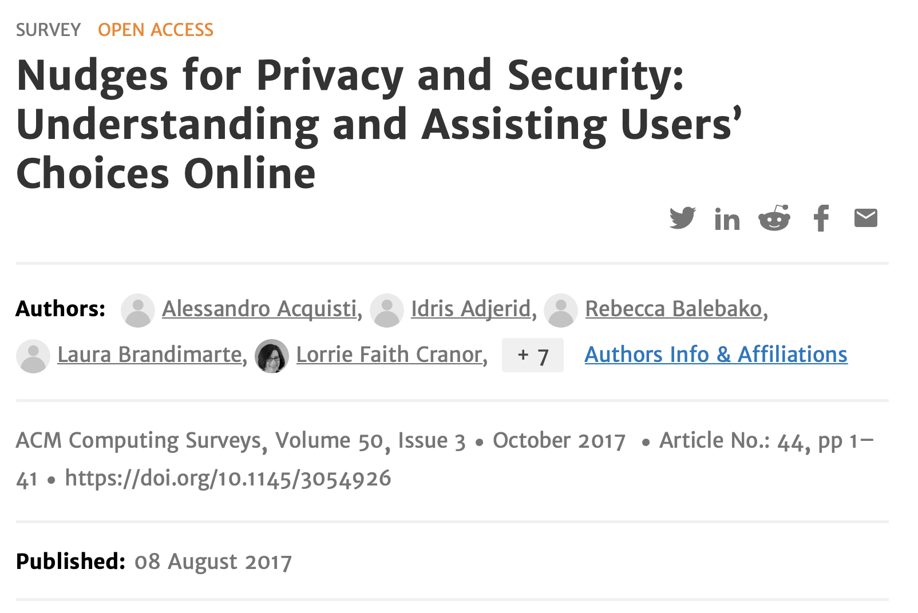
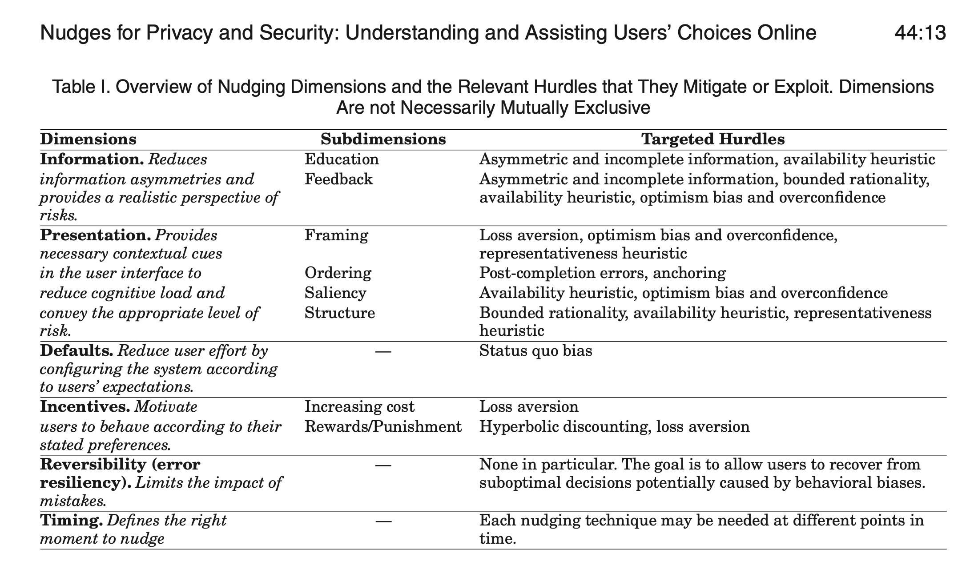

Slide 62
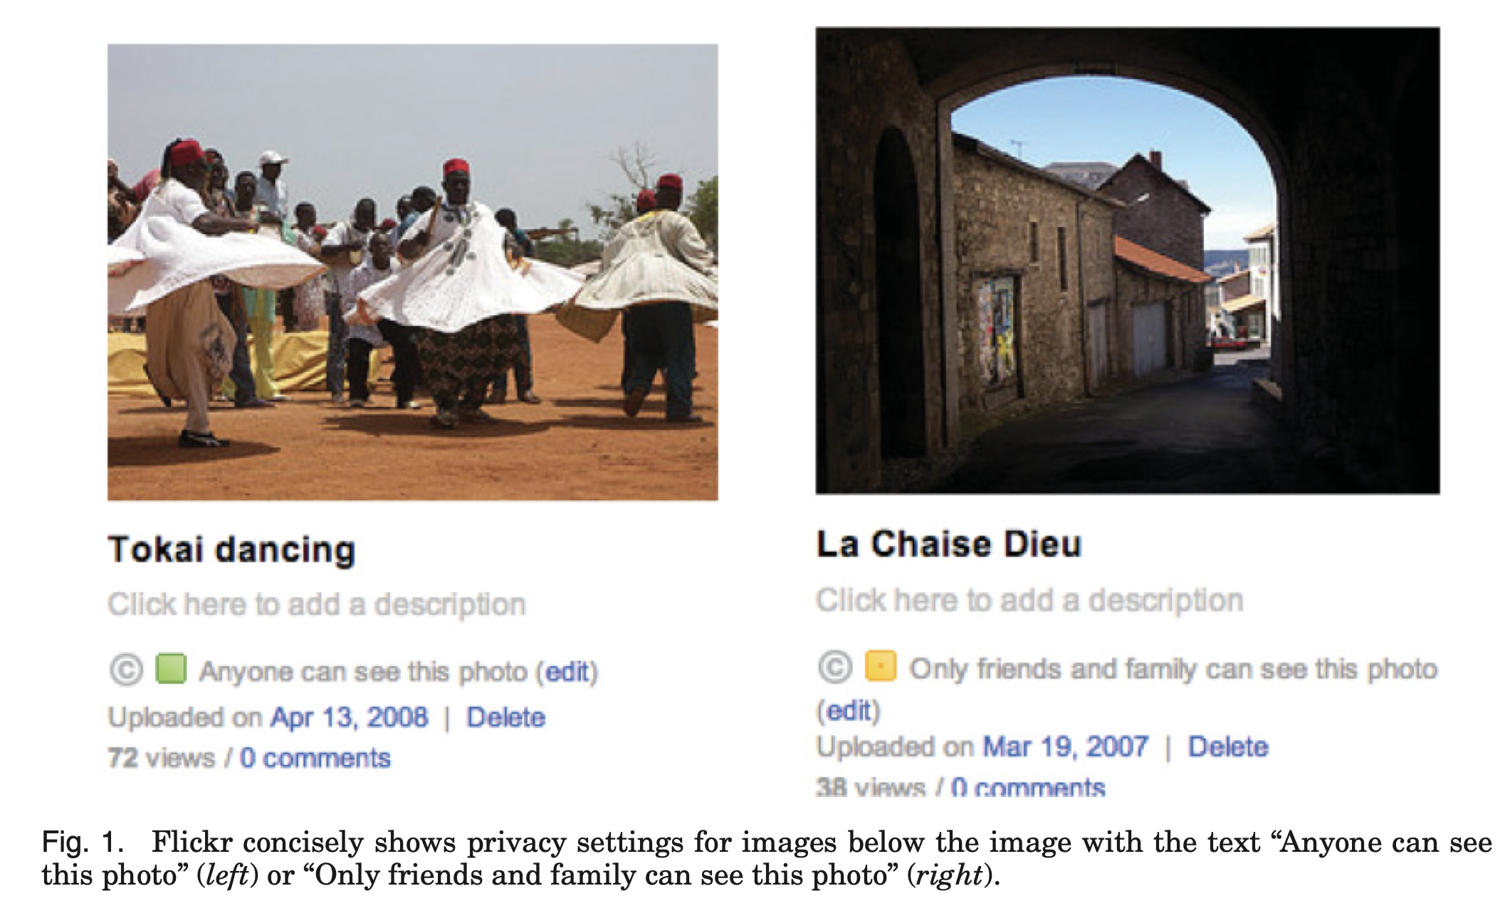
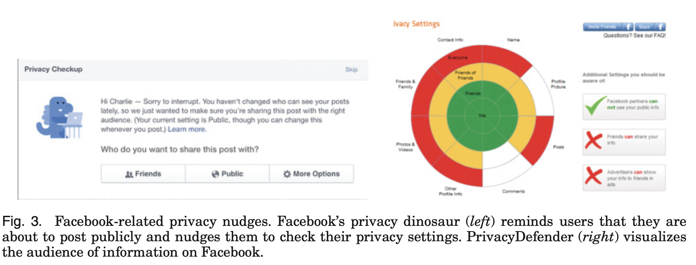
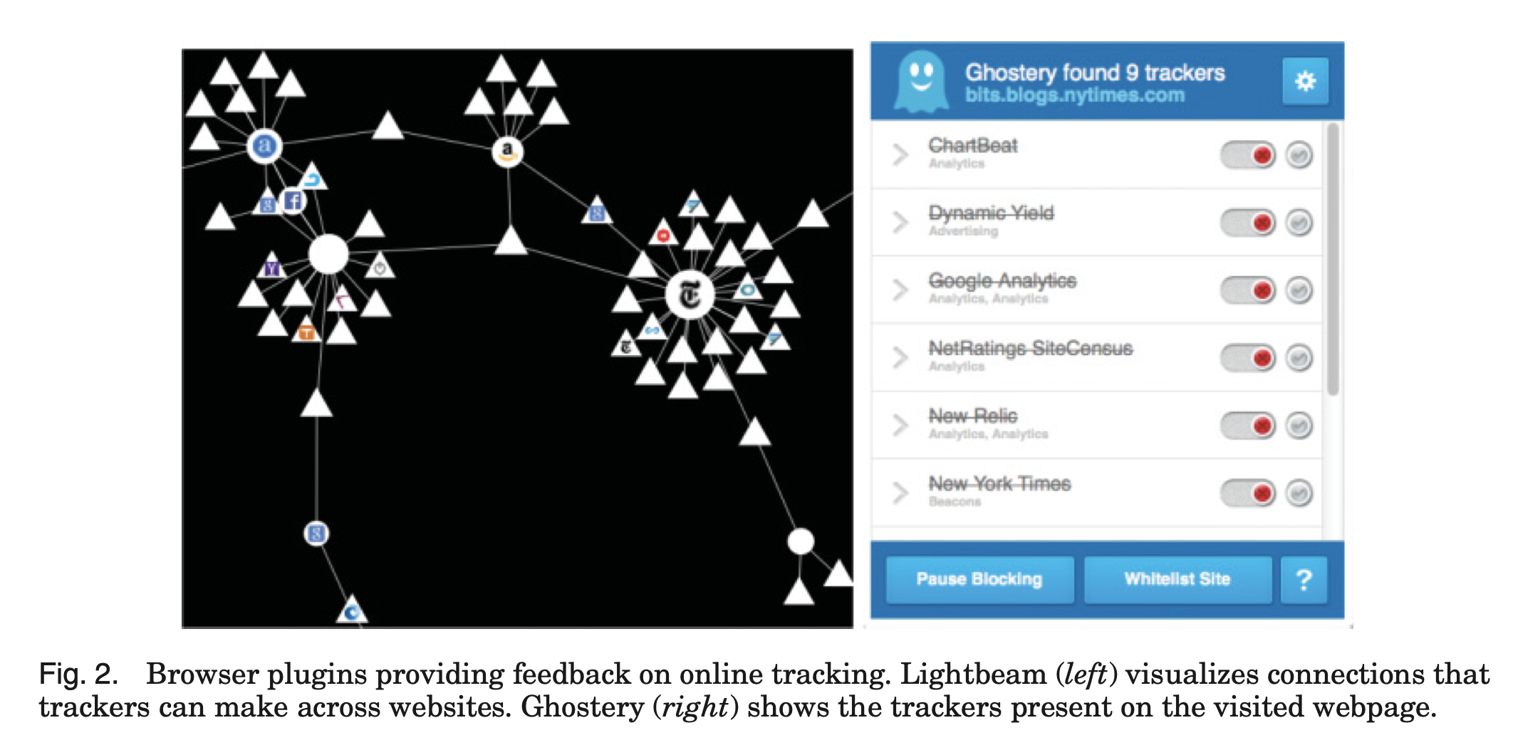

Slide 63
Privacy by Design

Slide 64
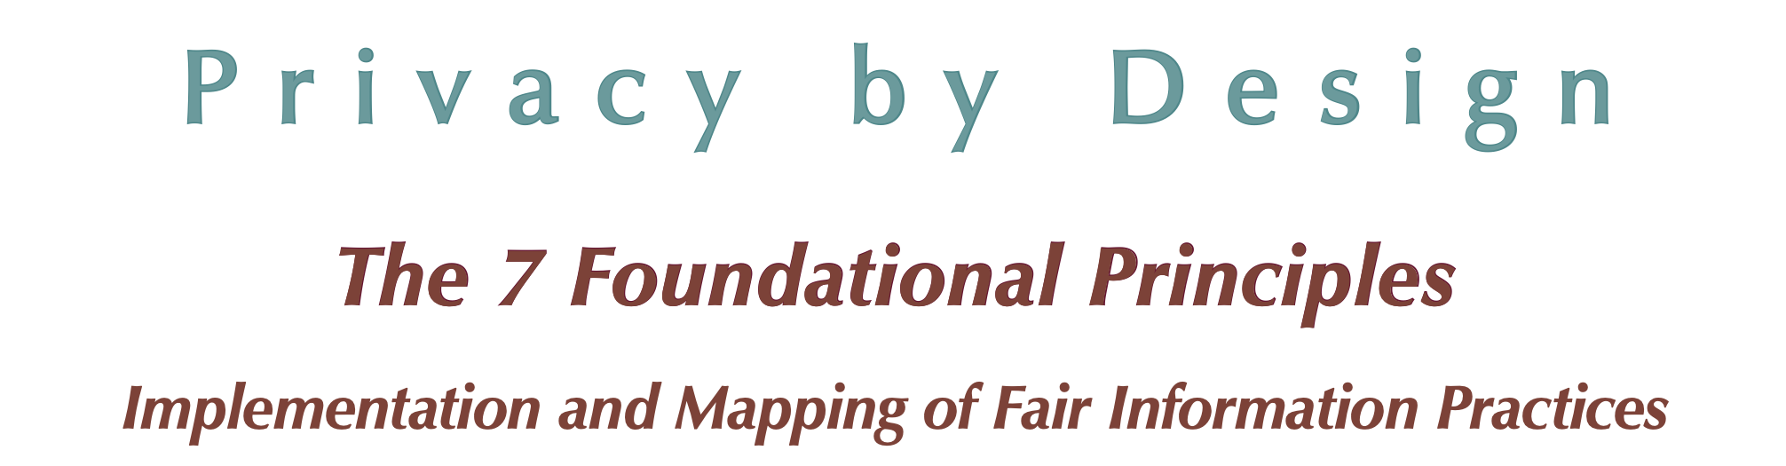
Cavoukian, A. Privacy by Design Curriculum 2.0, 2011; http://privacybydesign.ca/publications/

Slide 65
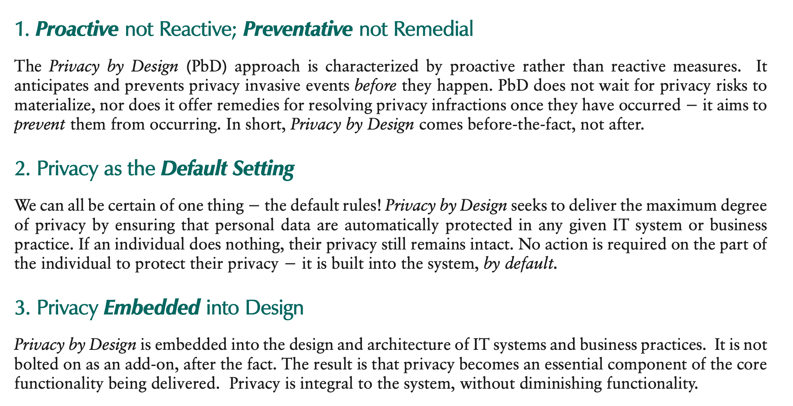

Slide 66
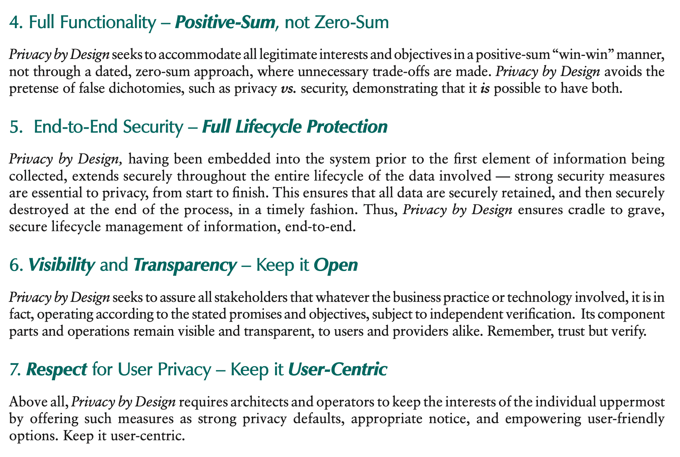

Slide 67
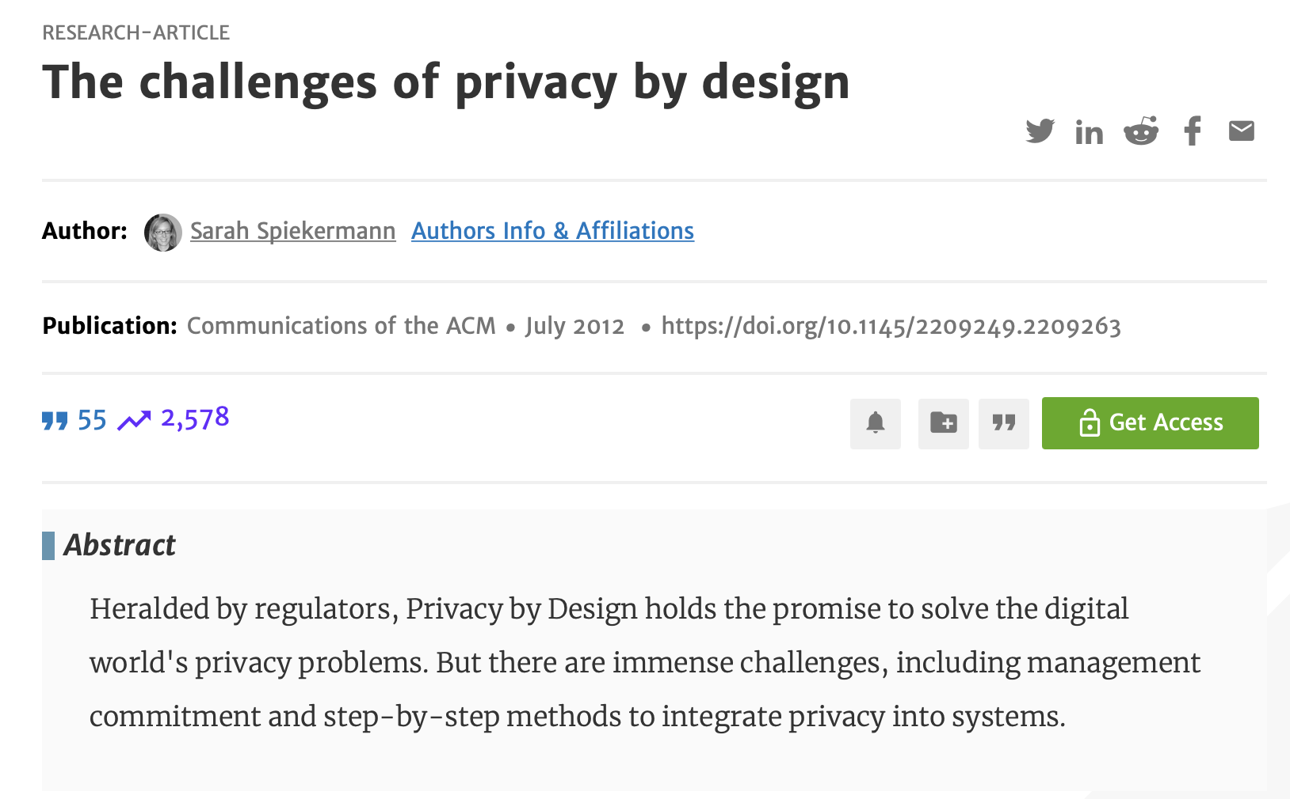
Privacy is a fuzzy concept and is thus difficult to protect.
Privacy is confounded with security.
There is no agreed-upon methodology for the systematic engineering of privacy into systems.
Little knowledge exists about the tangible and intangible benefits and risks associated with companies’ privacy practices.
https://dl.acm.org/doi/pdf/10.1145/2209249.2209263?casa_token=_iycepWilNAAAAAA:td2qPOxJDfEjTQVUsMm1ir5BO0FbJYSyi0ns8-mkpmP6sGRsAvMYGU1eq3wc_lJkQ3PraOa_PdC8jw

Slide 68
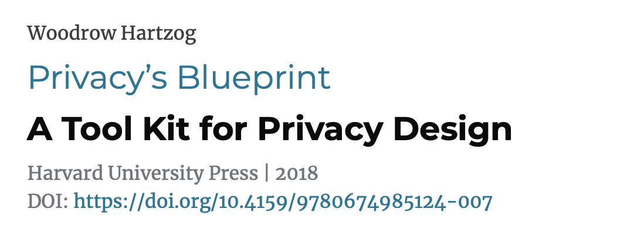
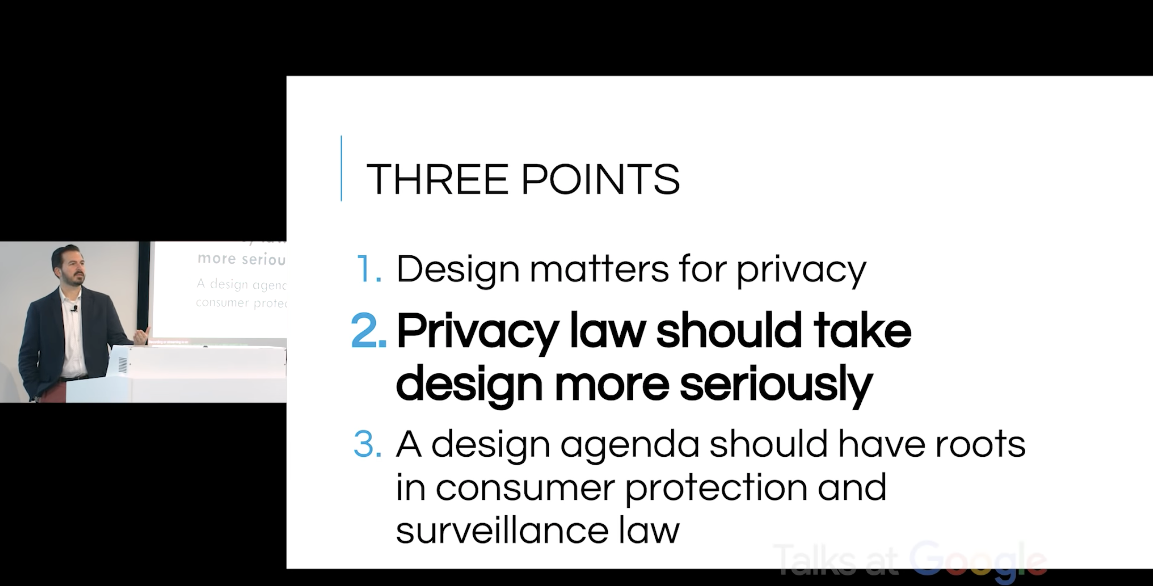
Watch Prof. Hartzog speak at Google:
https://www.youtube.com/watch?v=37E_11Zr-Fc

Slide 69
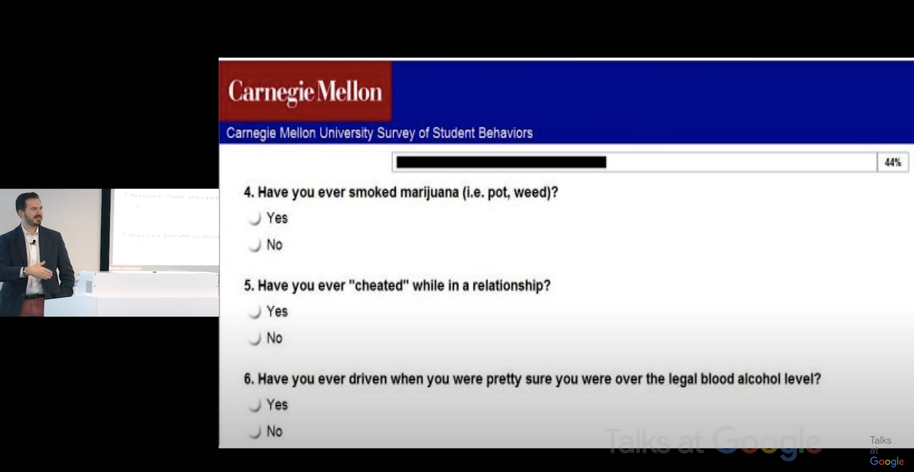
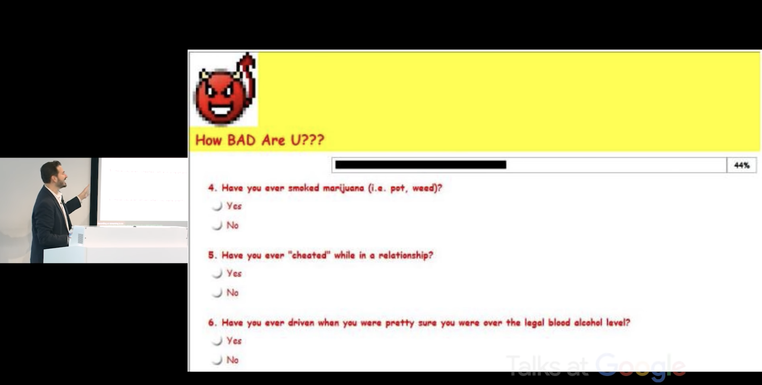
Claim: There is no such thing as neutral technology

Slide 70
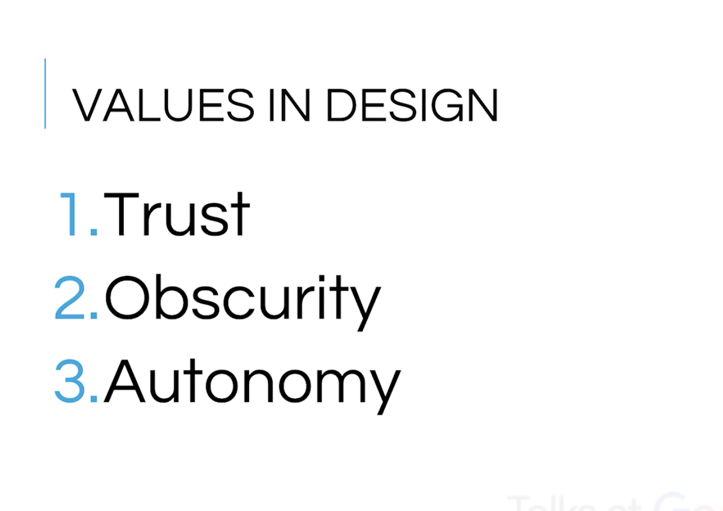
Note: Control is not here.

Slide 71
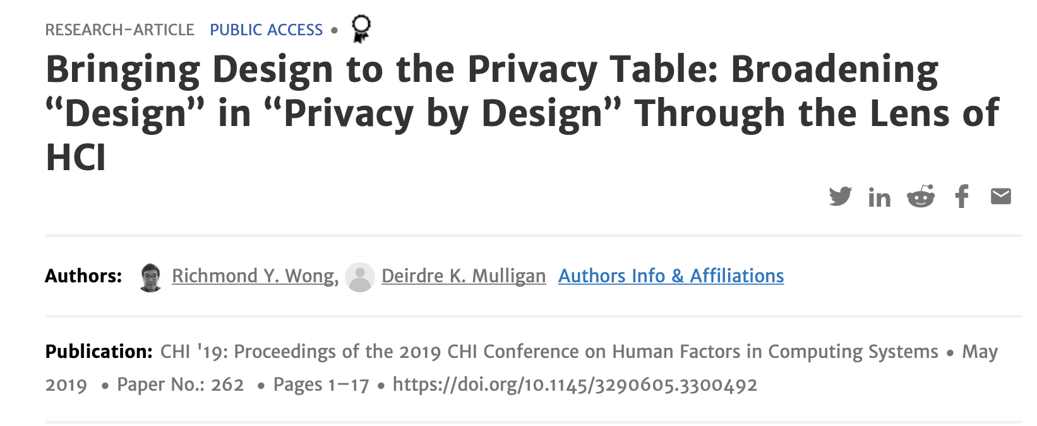
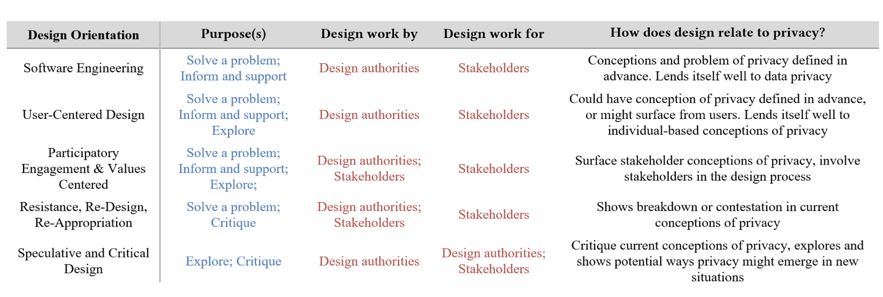

Slide 72
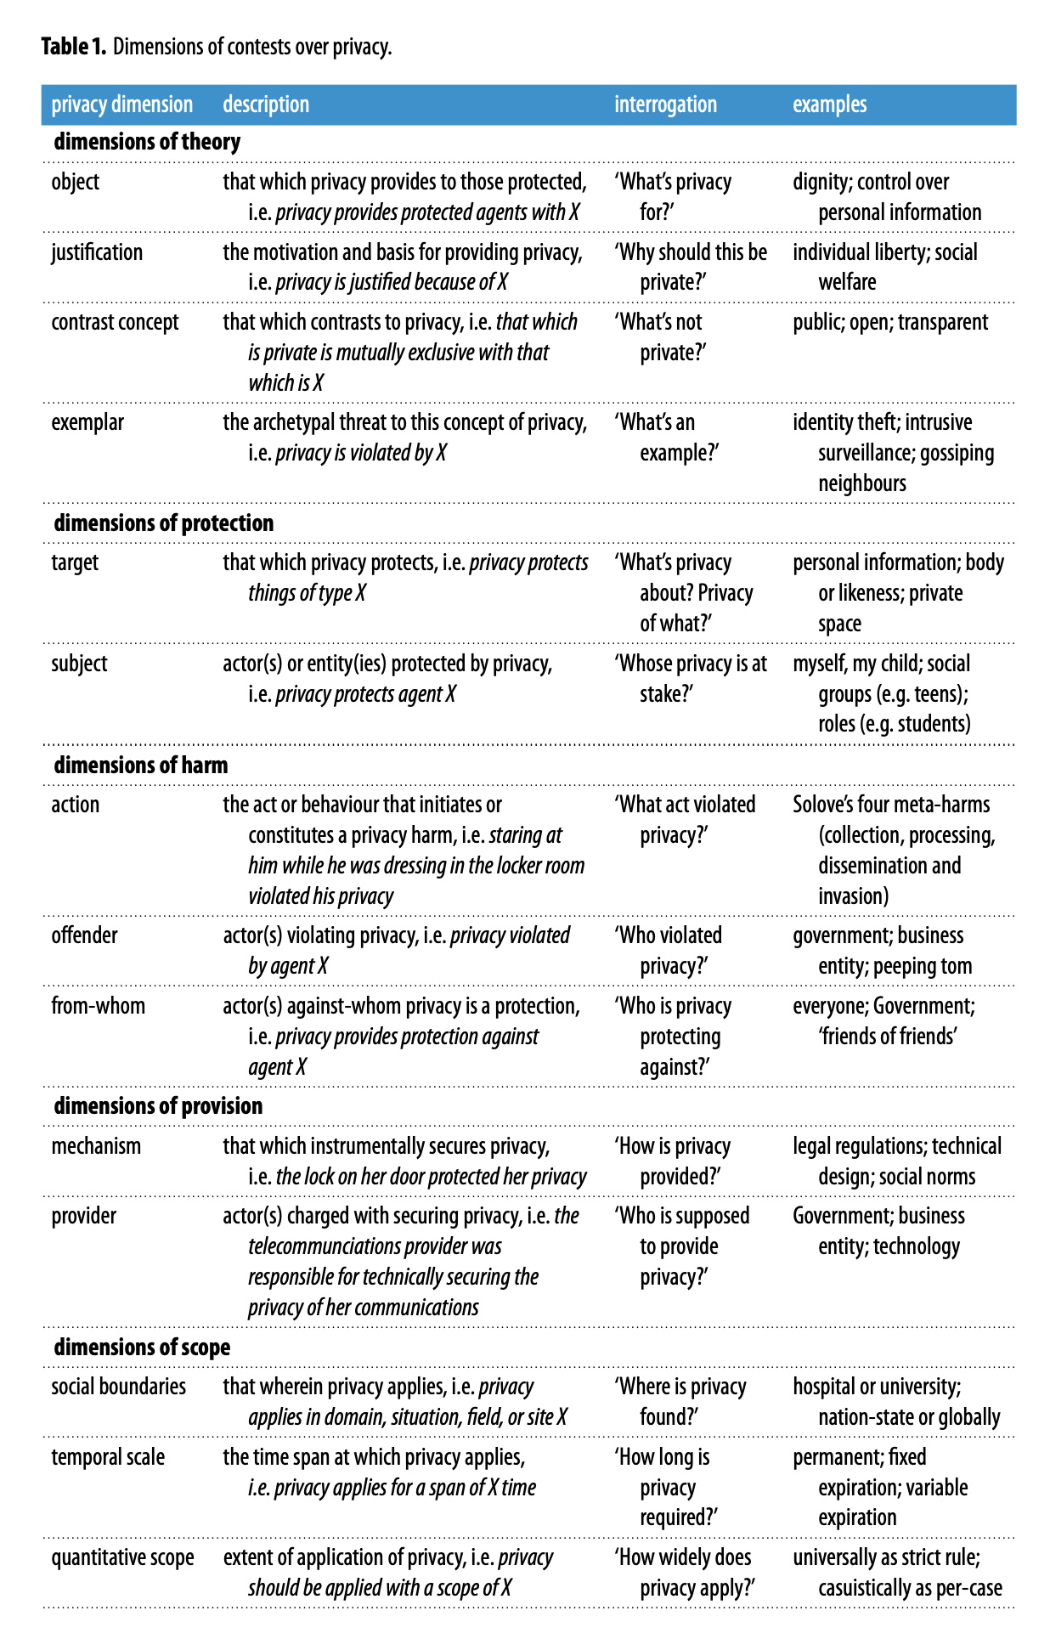
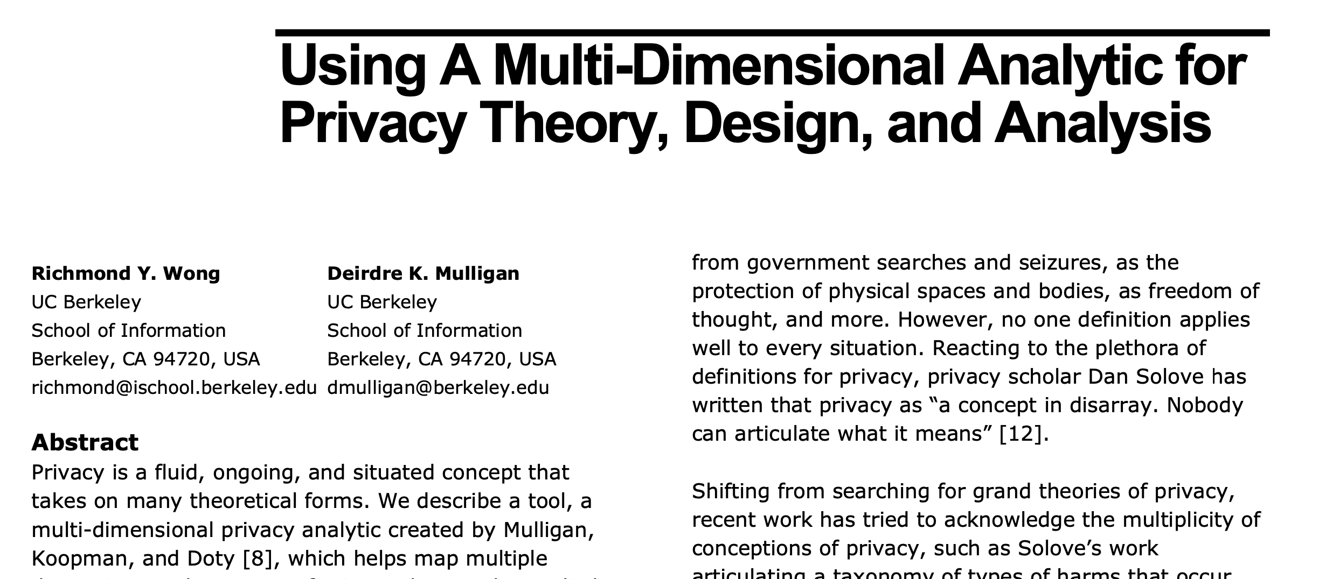
https://royalsocietypublishing.org/doi/pdf/10.1098/rsta.2016.0118
Try this game!
https://evidlab.umd.edu/privacy-by-design-the-game
Notes:
https://royalsocietypublishing.org/doi/pdf/10.1098/rsta.2016.0118

Slide 73
Is “choice” always meaningful choice?

Slide 74
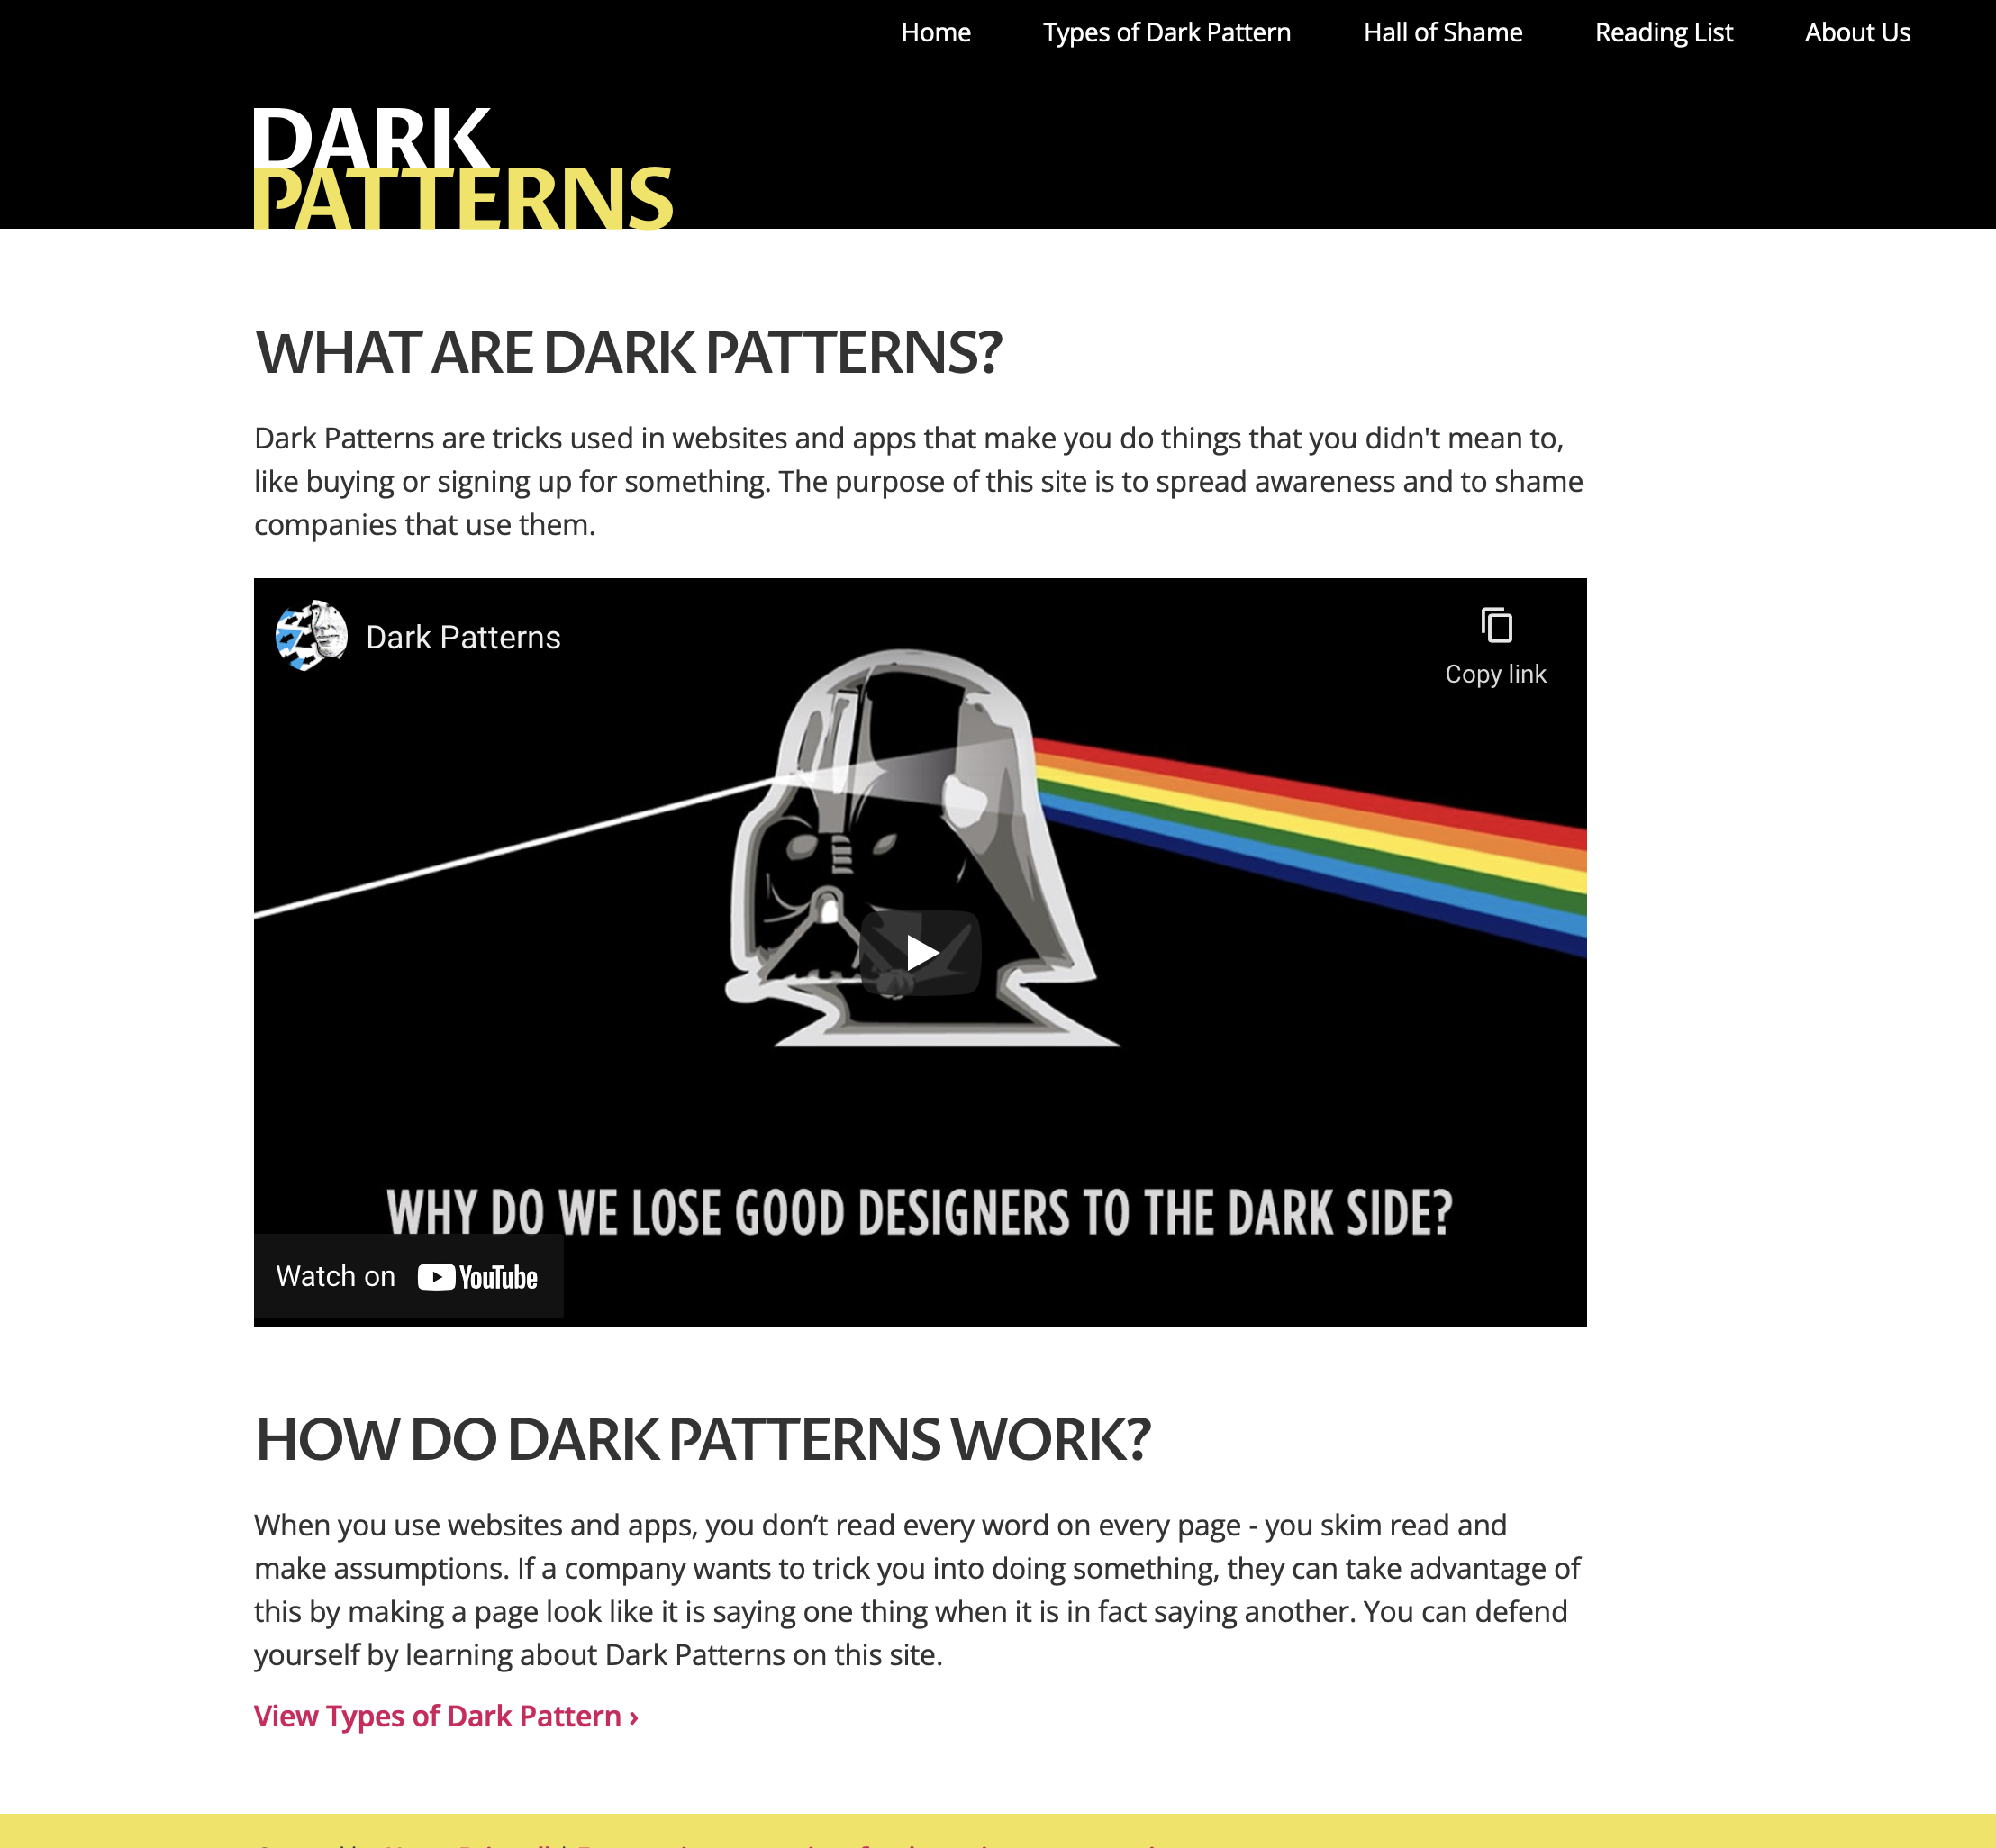

Slide 75
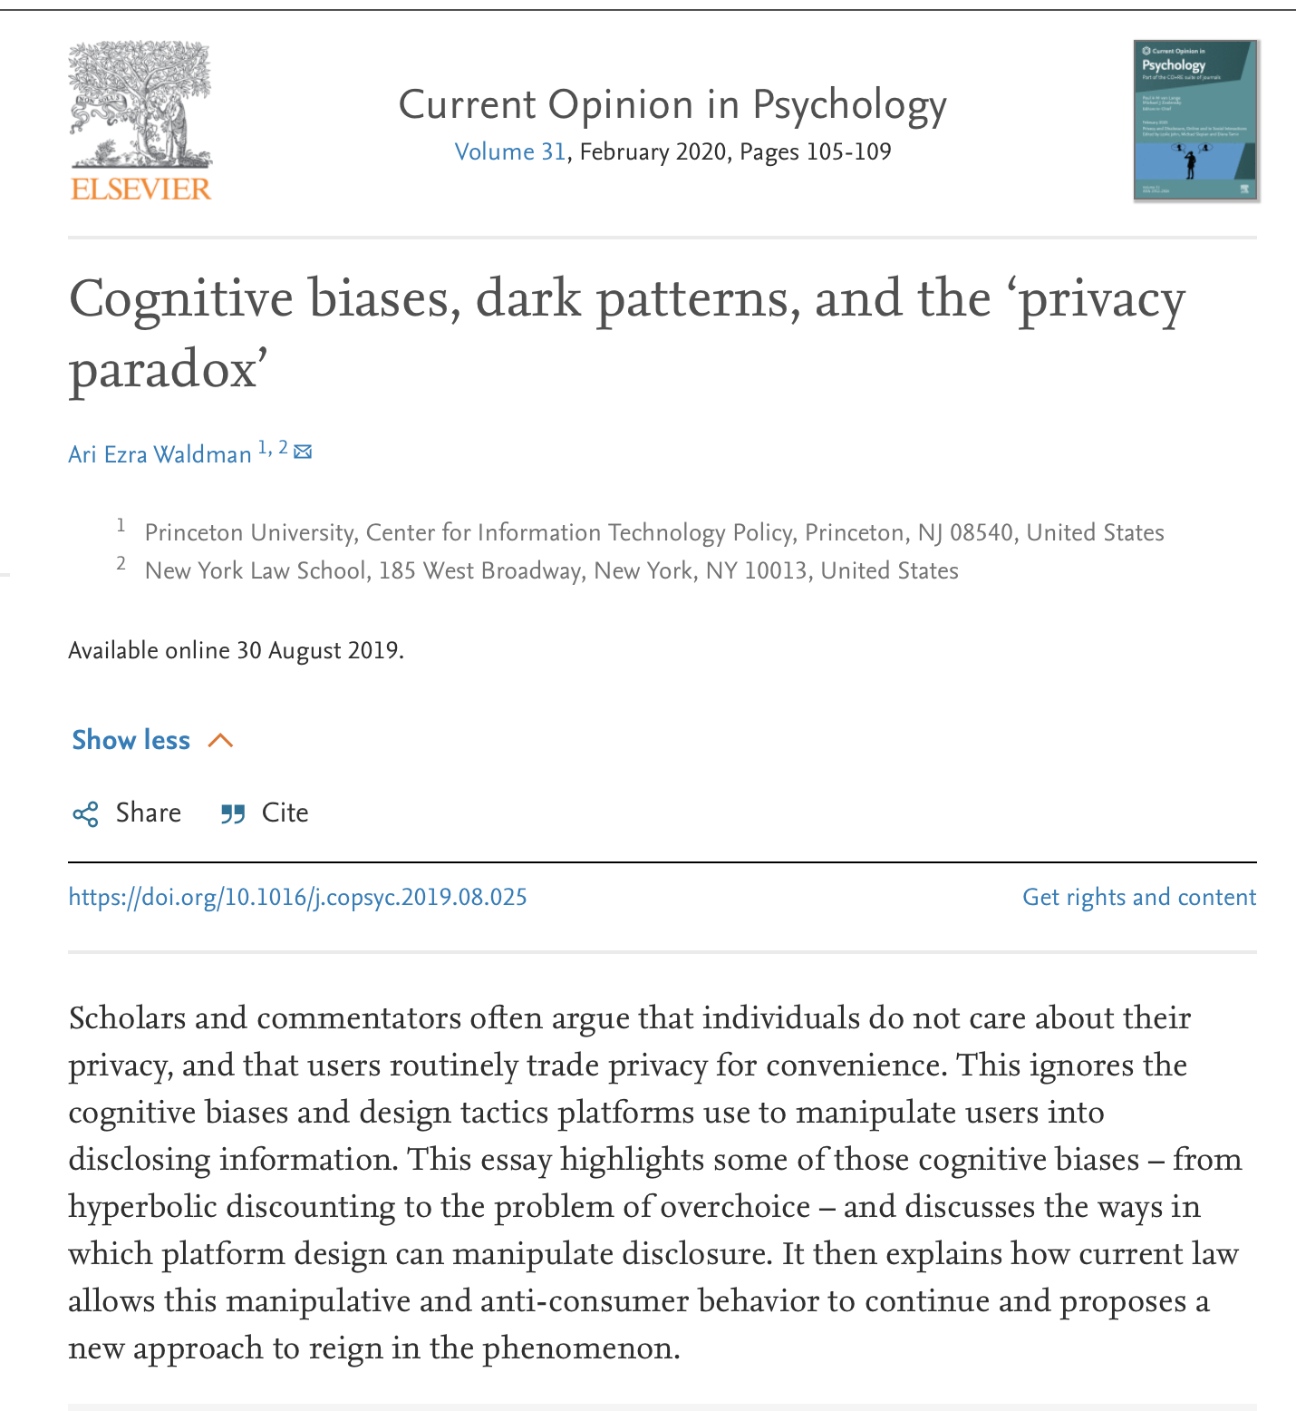

Slide 76
What are the concerns?
– Information becoming public
– Information becoming available to some
– Concentration of power in organizations who perform mass data collection and analysis
– Thoughts?

Slide 77
Threats to privacy

Slide 78
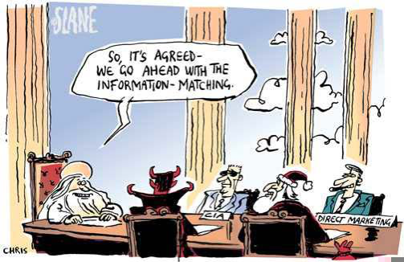
Data privacy and big data
Mobility patterns
Social data
Financial, health…
https://experience.arcgis.com/experience/ed2def13f9b045eda9f7d22dbc9b500e
Types of shared data
–Gives: the content you upload or share
–Give-aways: clicks, search queries, behavior

Slide 79
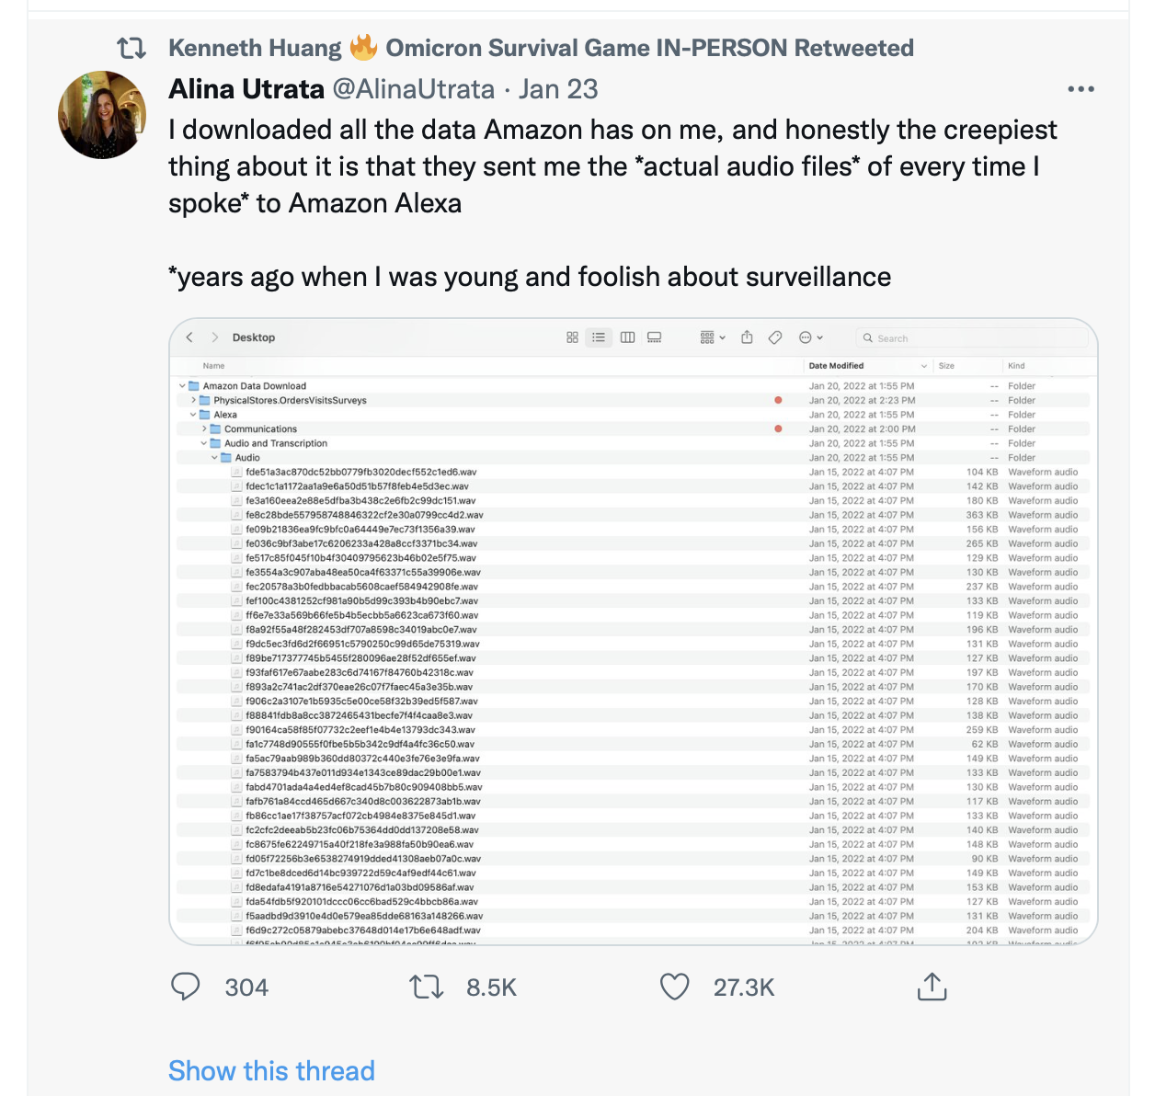
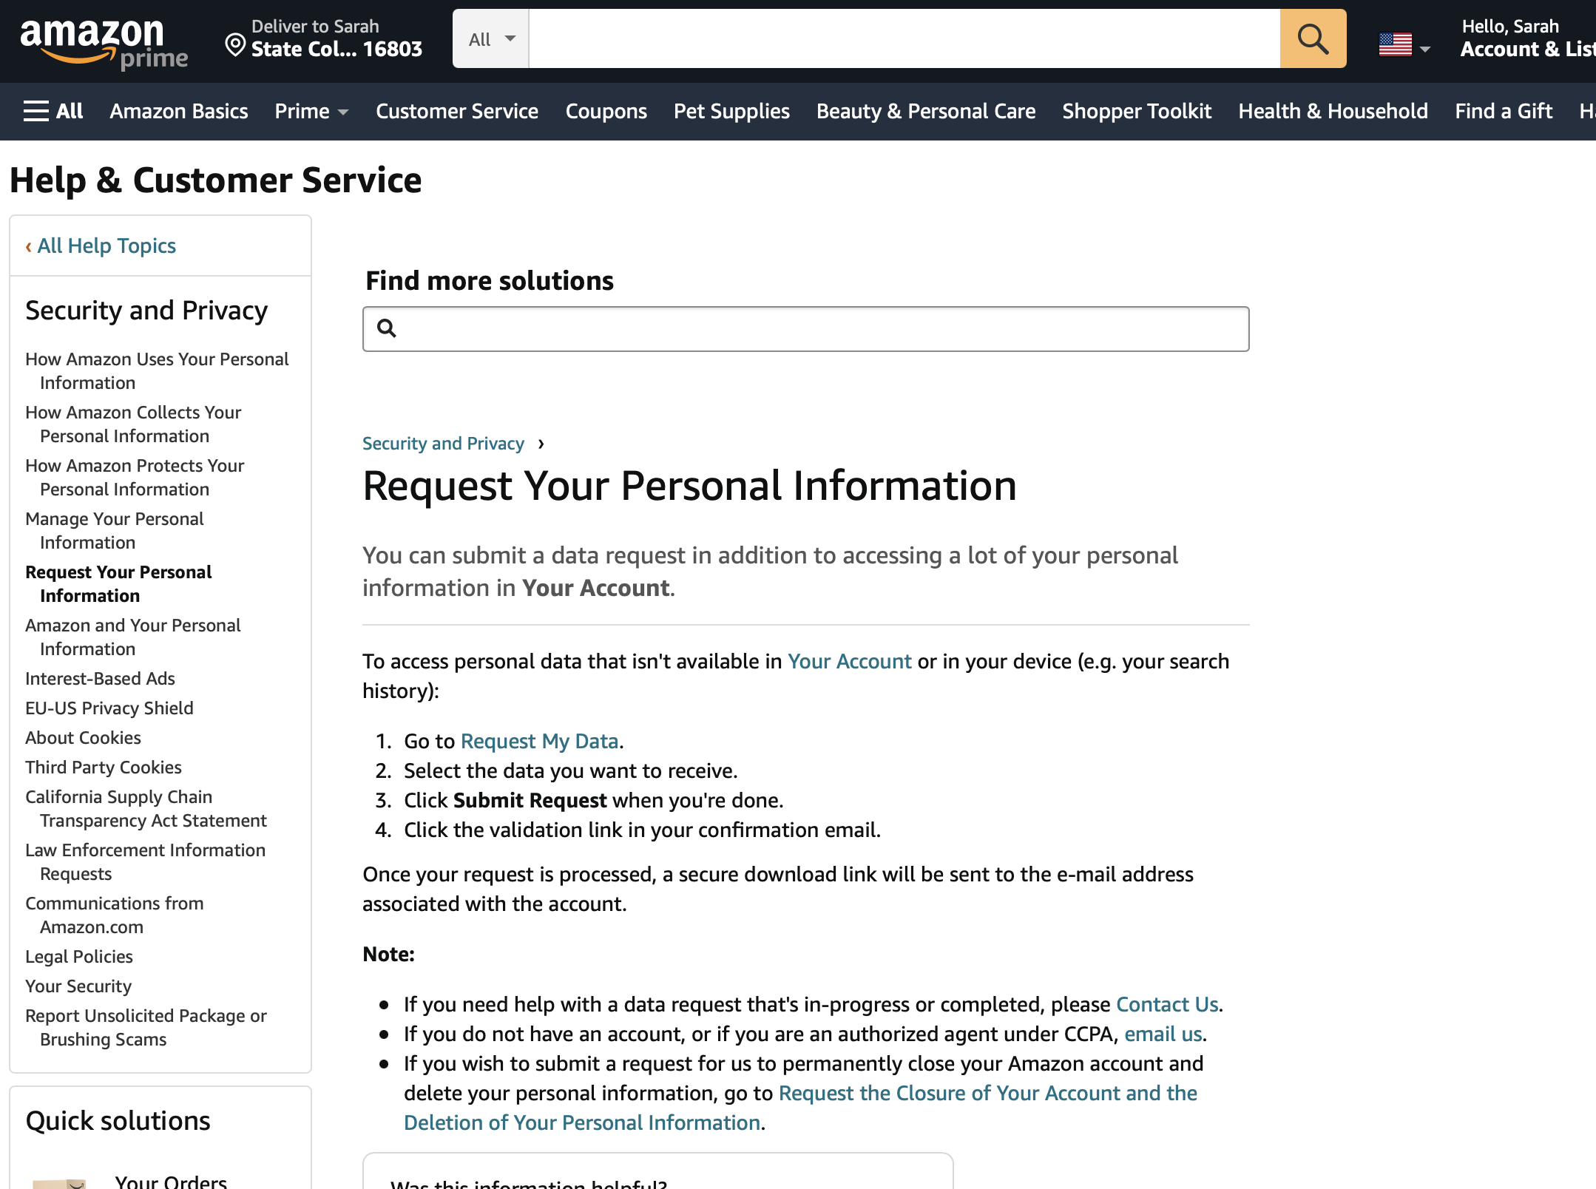
https://www.amazon.com/gp/help/customer/display.html?nodeId=GXPU3YPMBZQRWZK2

Slide 80

Facial recognition works by examining biometric information on a user and comparing it against photos from a database
Uses of facial recognition:
Phone and laptop security authentication
Law enforcement and surveillance
Airports
Social Media
Marketing and advertising

Slide 81


Slide 82
Threats to Privacy
Question for you:
Where is ”security” in all of this?
Unauthorized, inappropriate or malicious analysis/use/sharing of personal data
Data Collection
Data Filtering/
Processing
Analysis
Publication/Usage

Slide 83
Data Privacy Violations
Information Leakage
Cookies on the Web
Inference
I know what you did…and what you are about to do
Information/Data unwanted usage
Recommendations a little too personal

Slide 84


OK CUPID data release
https://www.wired.com/2016/05/okcupid-study-reveals-perils-big-data-science/

Slide 85



Slide 86

Iceland genetic data
Large databse of citizens’ medical records, genealogy, genetic information. No Identifiers included.
ALL CITIZENS of ICELAND included
https://www.jstor.org/stable/29762639?seq=1#metadata_info_tab_contents
Notes:
https://www.cnbc.com/2017/04/06/icelands-genetic-goldmine-and-the-man-behind-it.html

Slide 87


A Blue and White Case Study: “LIFT”
Stakeholders
Facts
Norms
Options

Slide 88
Privacy and its intimate relationship with
Data discrimination/algorithmic bias

Slide 89




Algorithmic discrimination
The growing use of algorithms in social and economic life has raised a concern: that they may inadvertently discriminate against certain groups.

Slide 90

Maybe it doesn’t matter much which images Google Search pops up, but what about in other contexts we’ve discussed?
ML learns patterns in data. It predicts by extrapolating on those patterns.
We need to decide what that means.

Slide 91
Break & Brainstorm (10+20 mins)
Define your research field (current, future or wannabe)
2. Find a privacy-related problem in your research area
Could be problem-specific
Could be data-specific
Could be motivated by a past example or just forward-looking concern
3. Reason about:
Importance of the problems
Relevance
Countermeasures you know of
Create a (single) google slide.
Drop the link to it in the Canvas discussion board.

Slide 92
Time to share…

Slide 93
For next week: Ethics of Privacy
Read 2 things:
1. Nissenbaum’s “Deregulating Collection: Must Privacy Give Way to Use Regulation? (posted in Canvas)
2. This article: https://slate.com/technology/2014/11/big-data-underground-railroad-history-says-unfettered-collection-of-data-is-a-bad-idea.html
Fair warning: We will be having a debate :-) …
Thank you!

